Slide 1
Book Recommendation System

Slide 2
Mentor – Neha Gupta
Team Members –
Kunal Mallick
Ajay Anap
Parvati Tambe
Harsh Dalal
Mohammed Saad Qureshi
Sandeep Murud
Abhishek Bhonde

Slide 3
Objective -
We are a team of book enthusiasts who want to help people find their next favorite read. Our major objective is to recommend books to users based on their location and age group. We believe that these two factors can influence the preferences and interests of readers. By using our service, you can discover new books that match your taste and culture.
One way to design a book recommendation system is to use user reviews as a source of information. User reviews can provide insights into the book content and quality, which are important parameters for recommending books. A book recommendation system can filter user reviews based on various criteria, such as relevance, sentiment, length, and language, and use them to rank and suggest books to users.

Slide 4
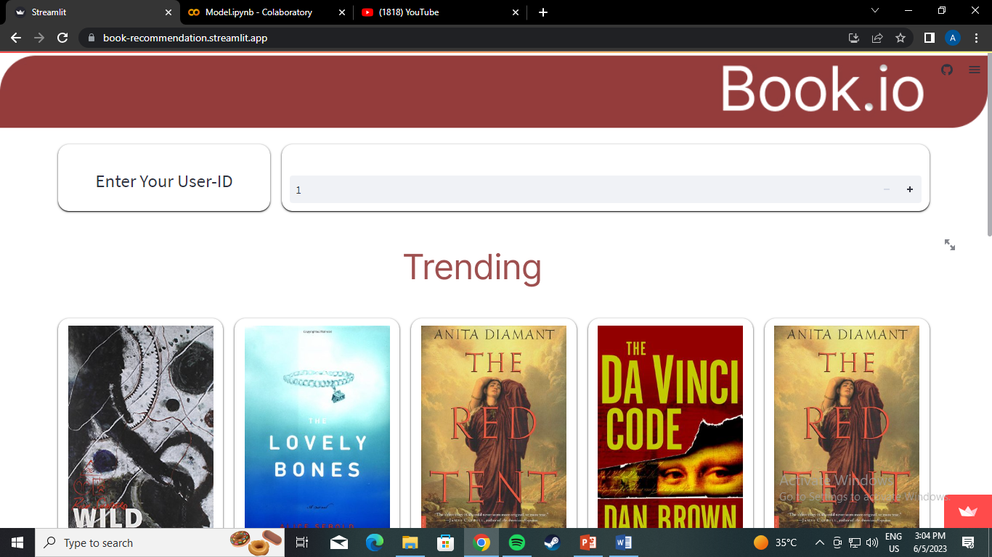
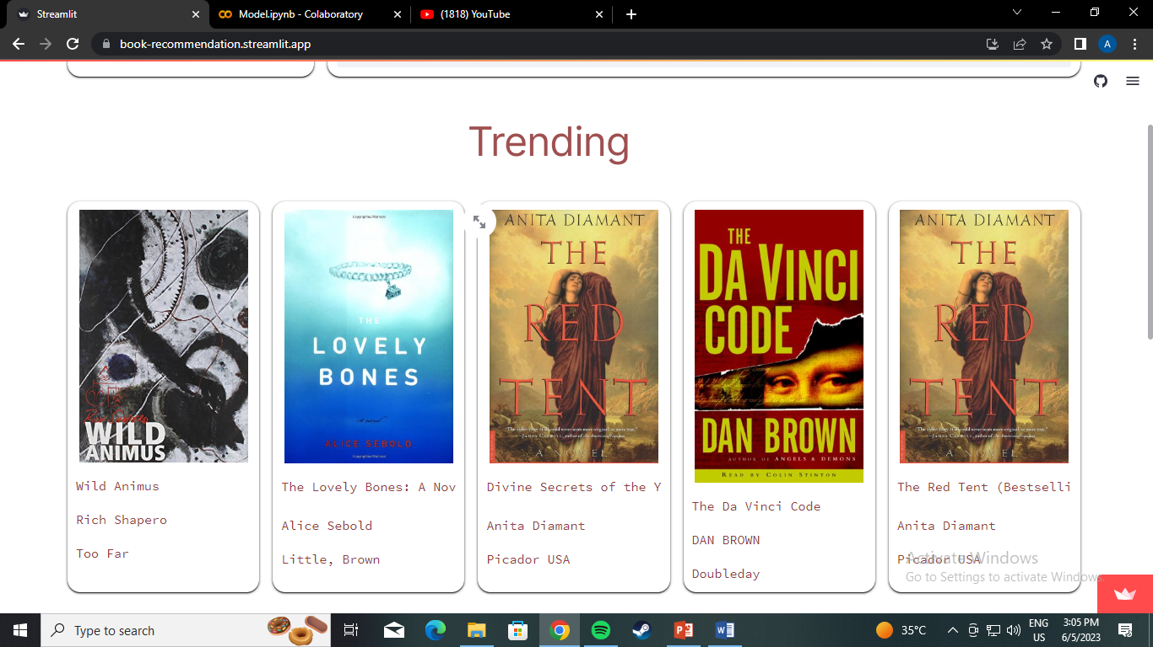
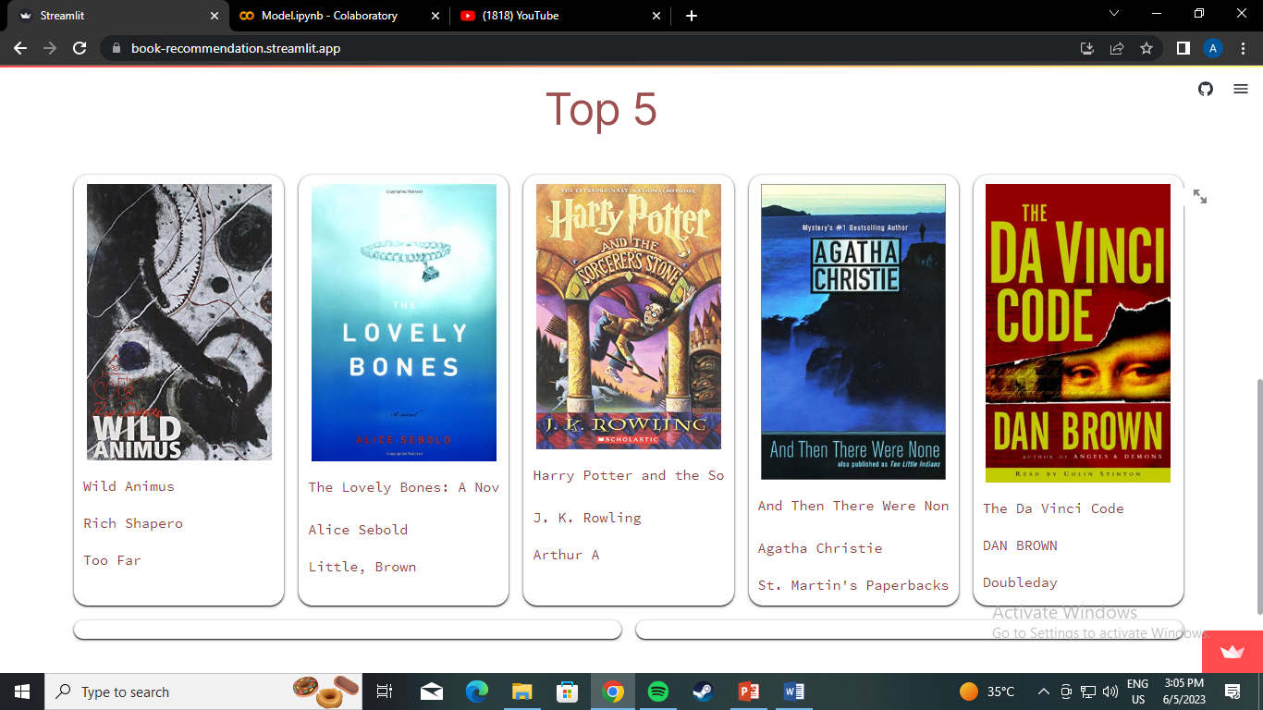
Model Building Pictures

Slide 5
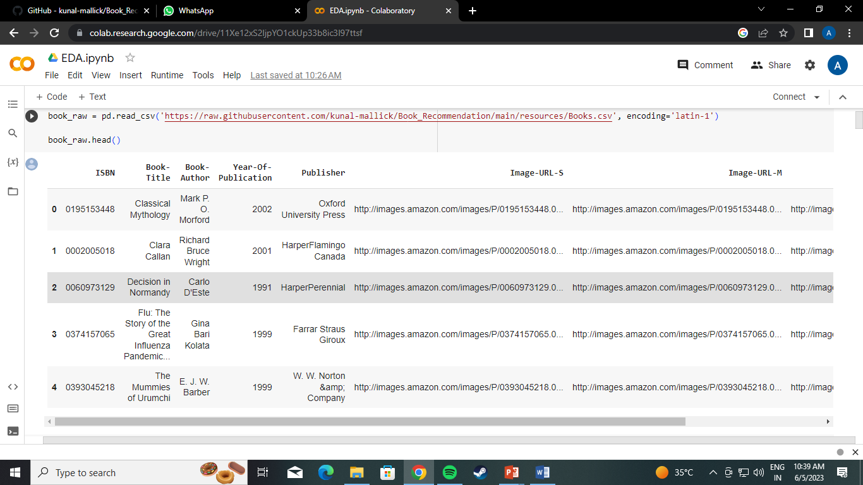
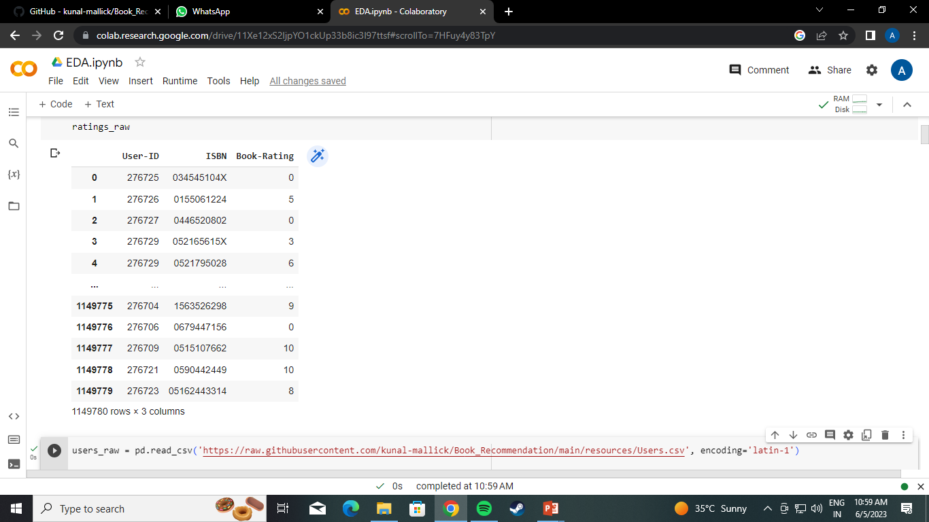
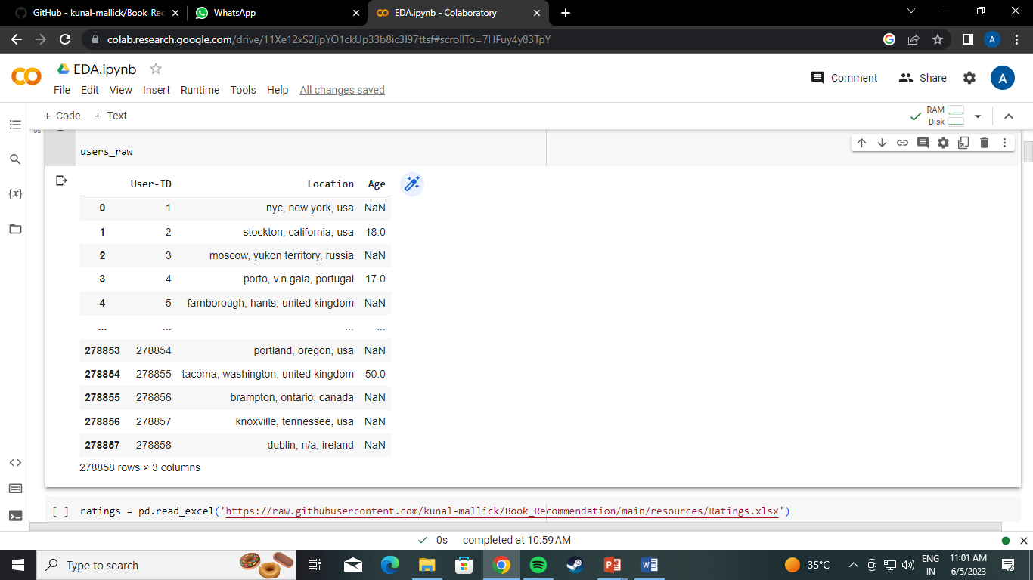
Loading The Datasets -
After loading the datasets checking for missing values percentage
unique values
duplicate values

Slide 6
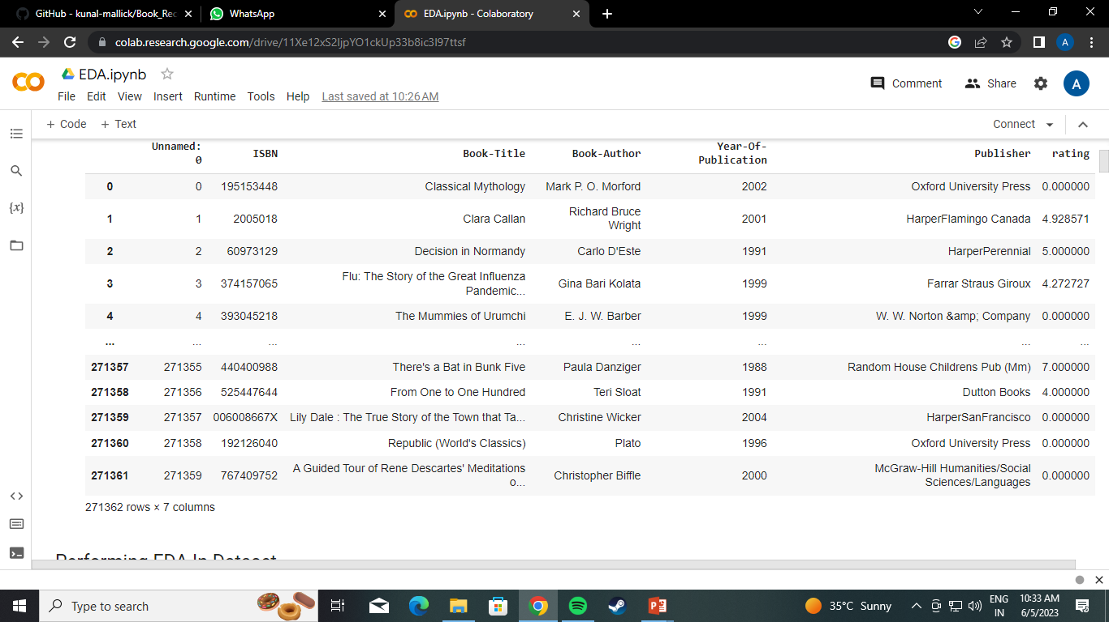
We merged the book dataset and rating dataset

Slide 7
Data Cleaning -
we removed duplicates values

Slide 8
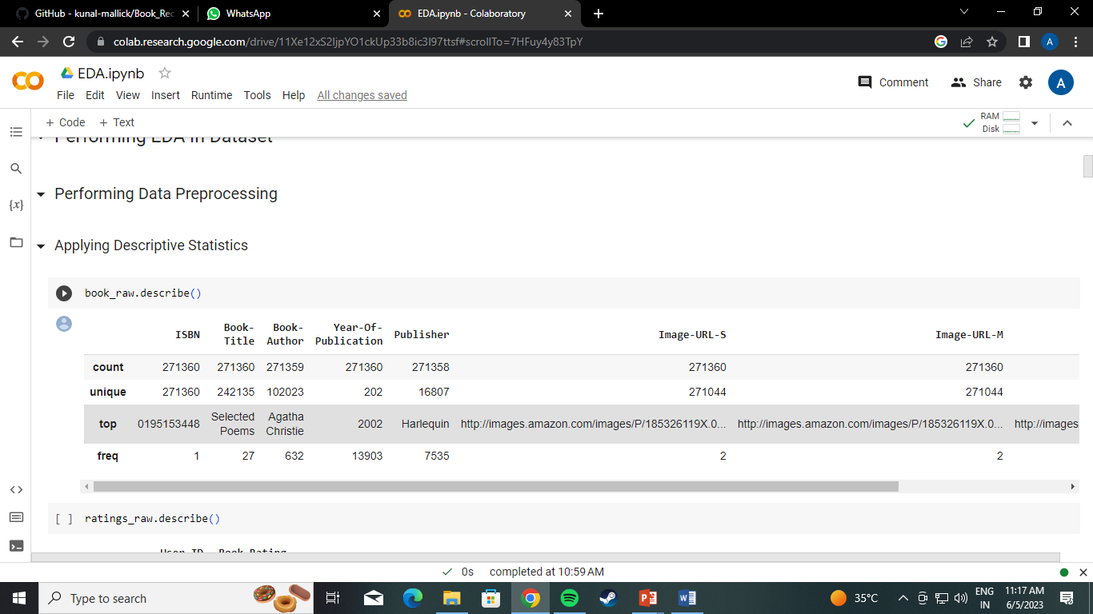
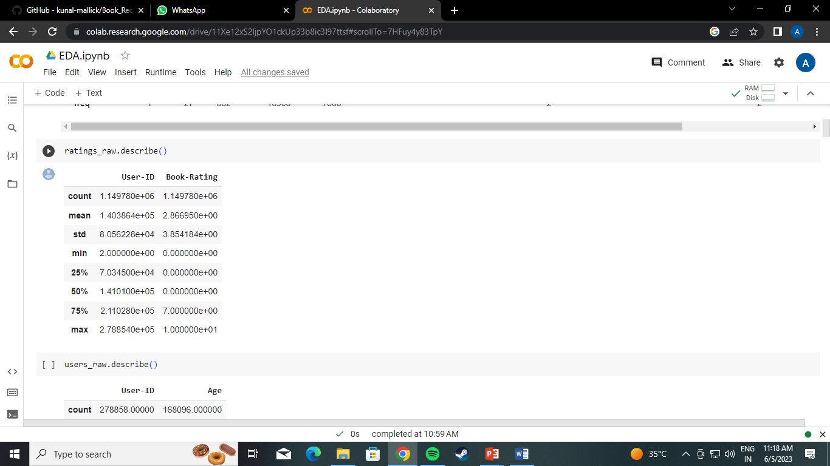
EDA -
In Book dataset there are 271360 rows x 8 columns
In Rating dataset there are 1149780 rows x 3 columns
In Users dataset there are 278858 rows x 3 columns
In Ratings there are 271362 rows x 7 columns
Duplicate values 0
Missing values percentage in users (age column) is 40 %
Describing all datasets :

Slide 9
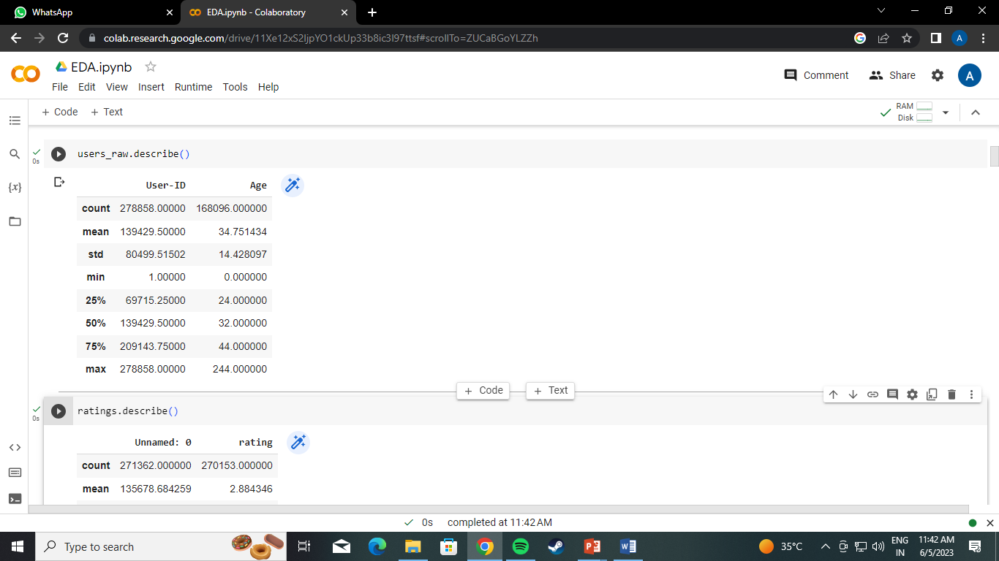
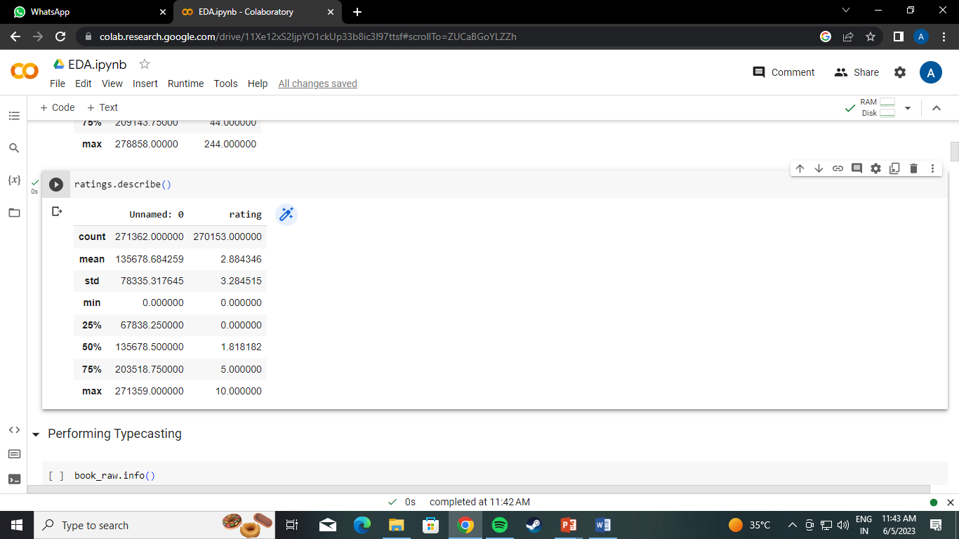

Slide 10
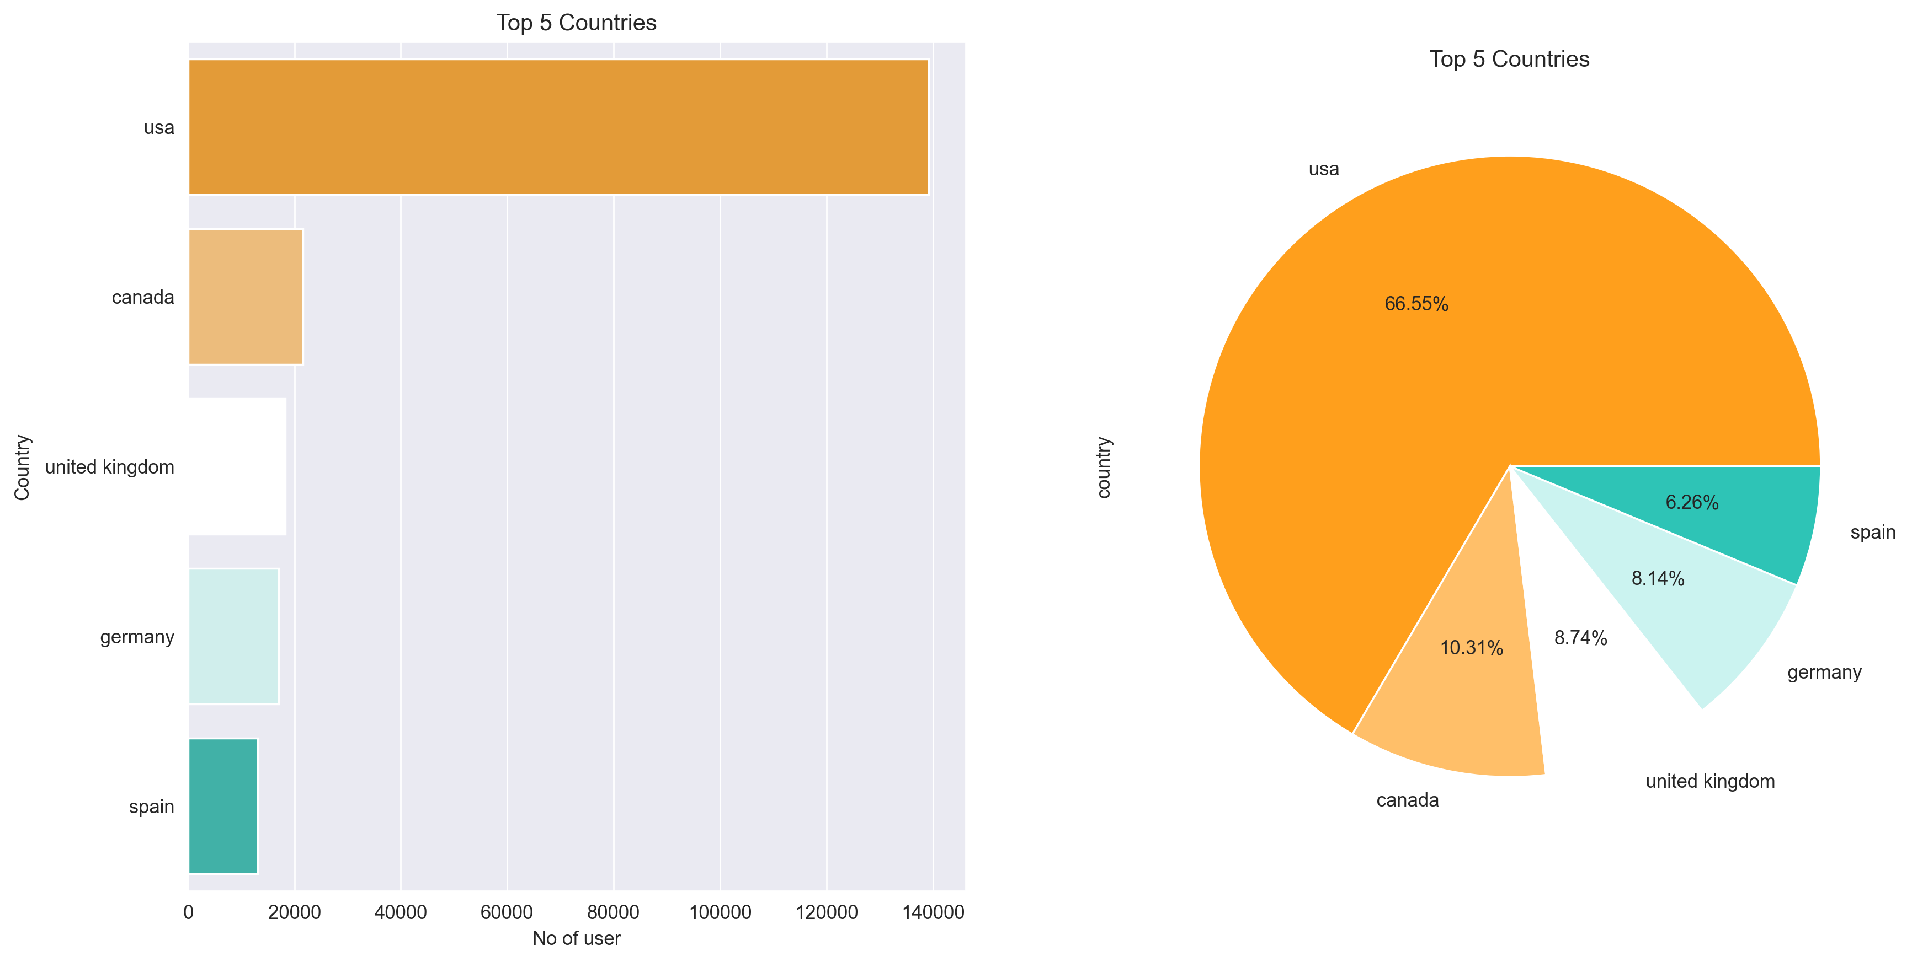
Data Visualization of Users
This graph displays the top five countries and their percentages

Slide 11
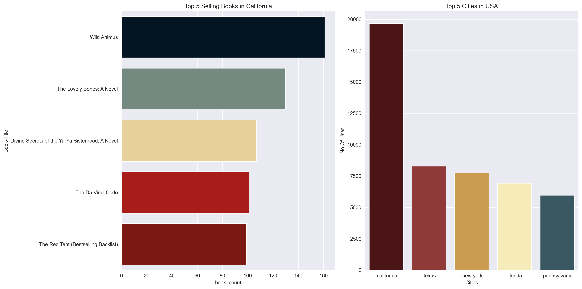
This graph shows california’s best-selling book and the top five American cities

Slide 12
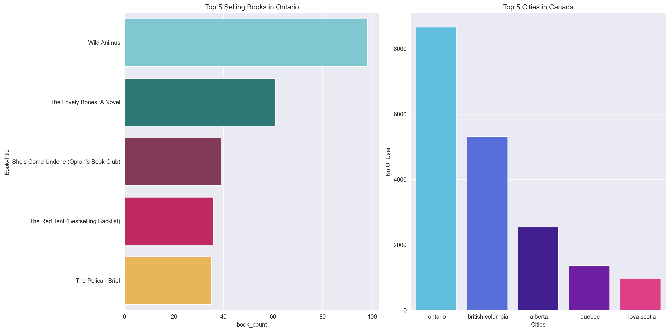
This graph shows Ontario’s best-selling book and the top five Canadian Cities

Slide 13
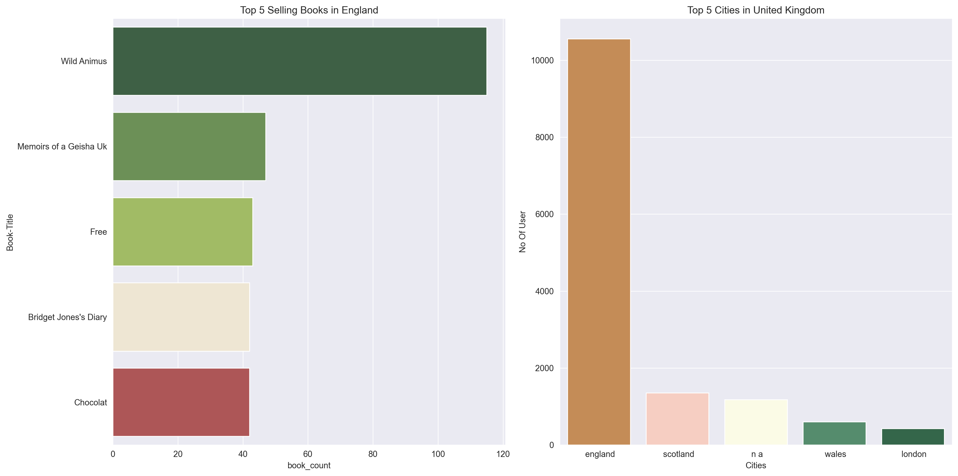
This graph shows England’s best-selling book and the top five United Kingdom Cities

Slide 14
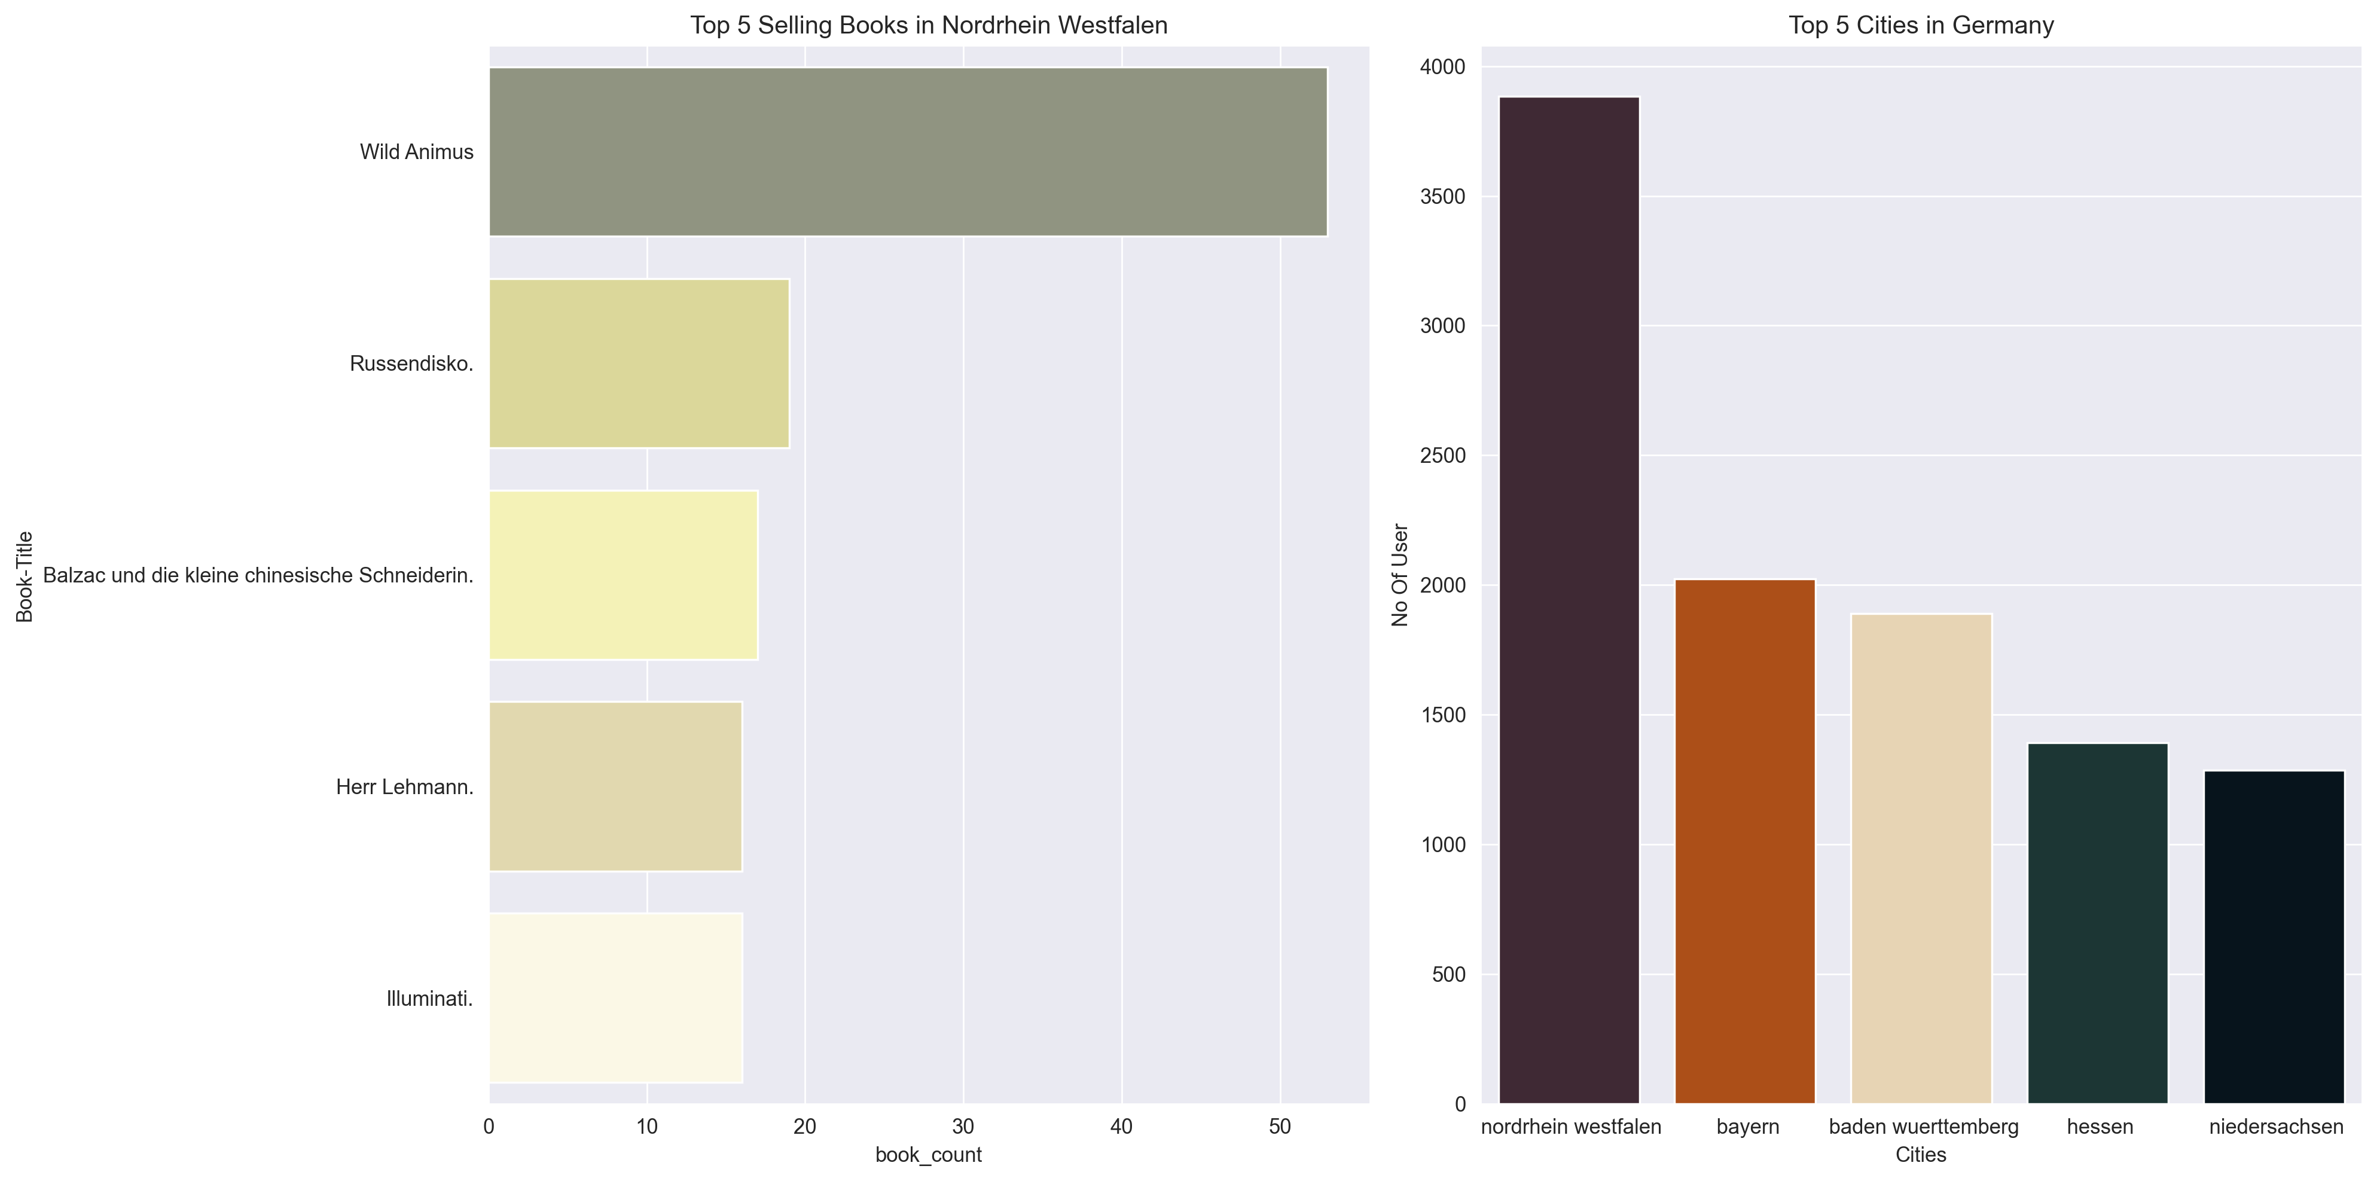
This graph shows Nordrhein Westfalen’s best-selling book and the top five German Cities

Slide 15
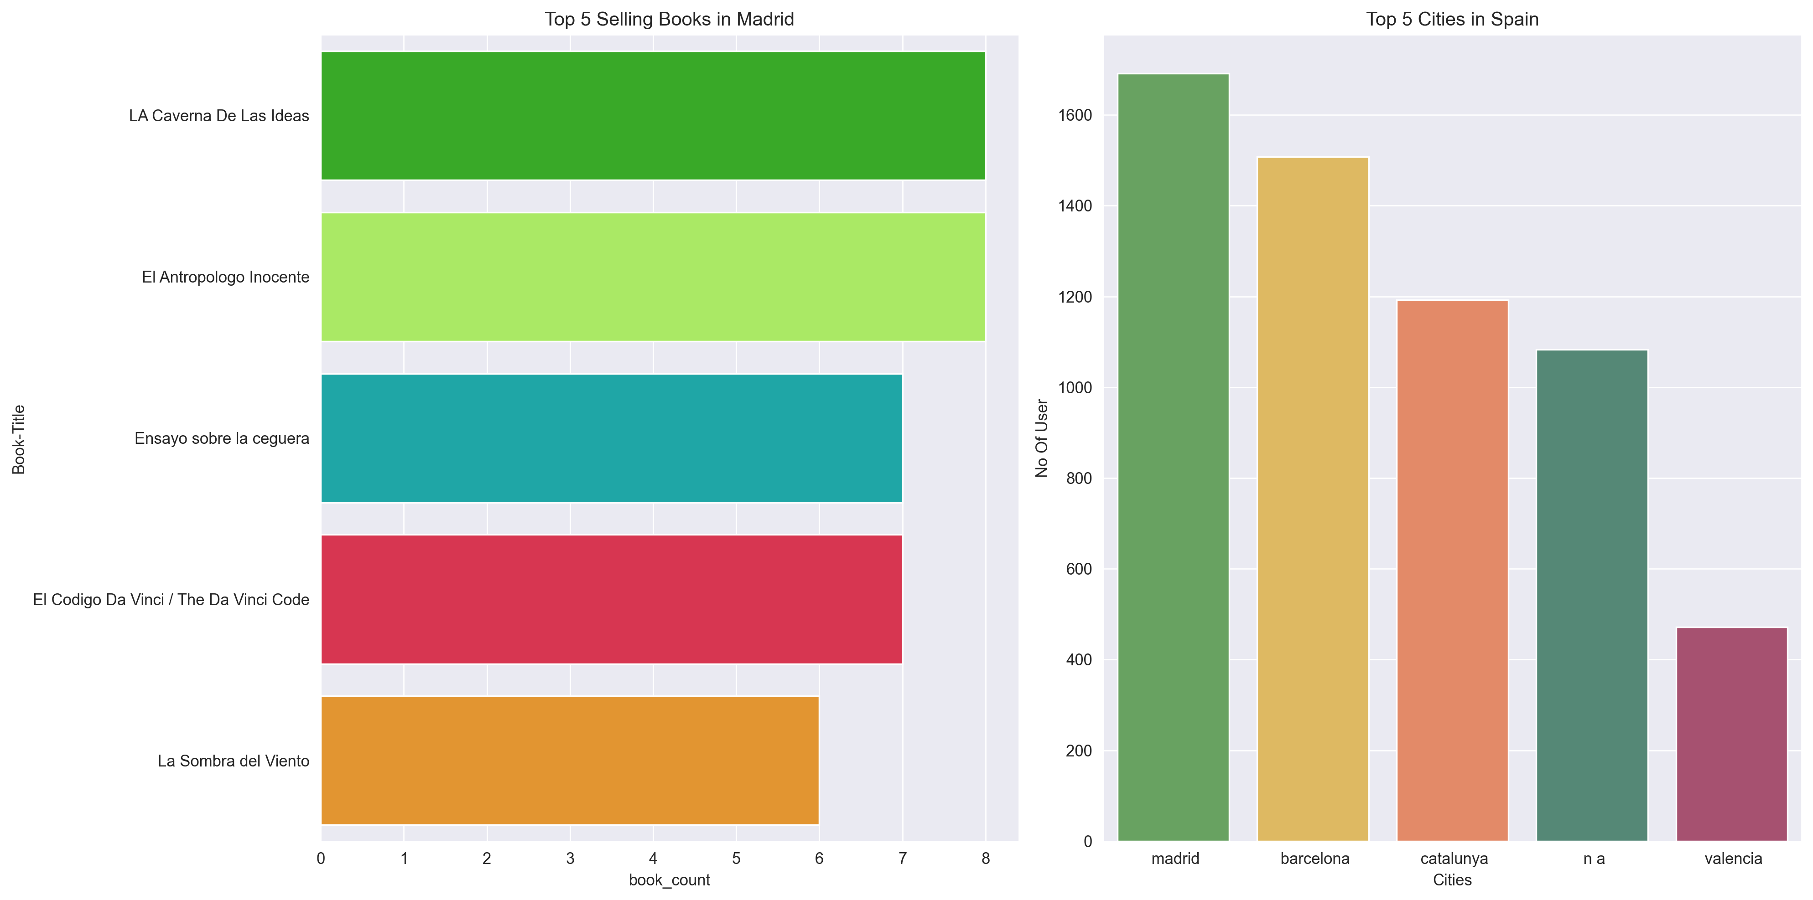
This graph shows Madrid’s best-selling book and the top five Eupoean Cities

Slide 16
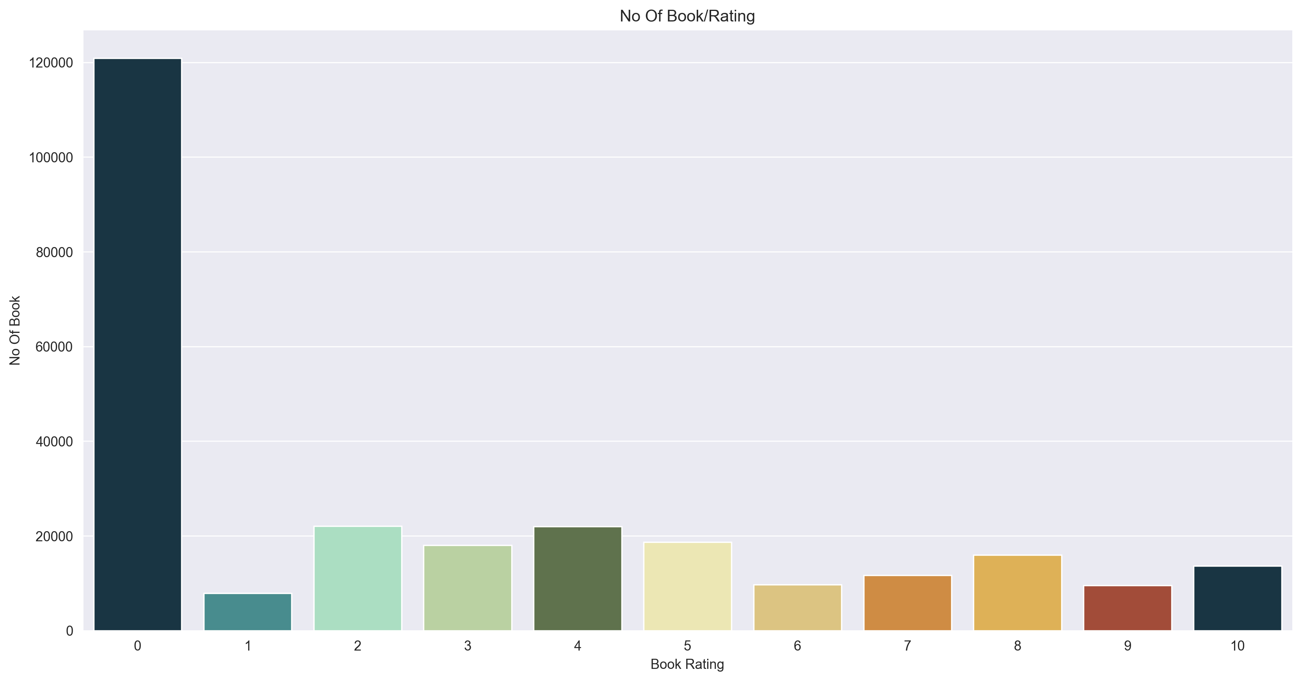
Data Visualization of Rating
The graph displays the number of books per rating

Slide 17
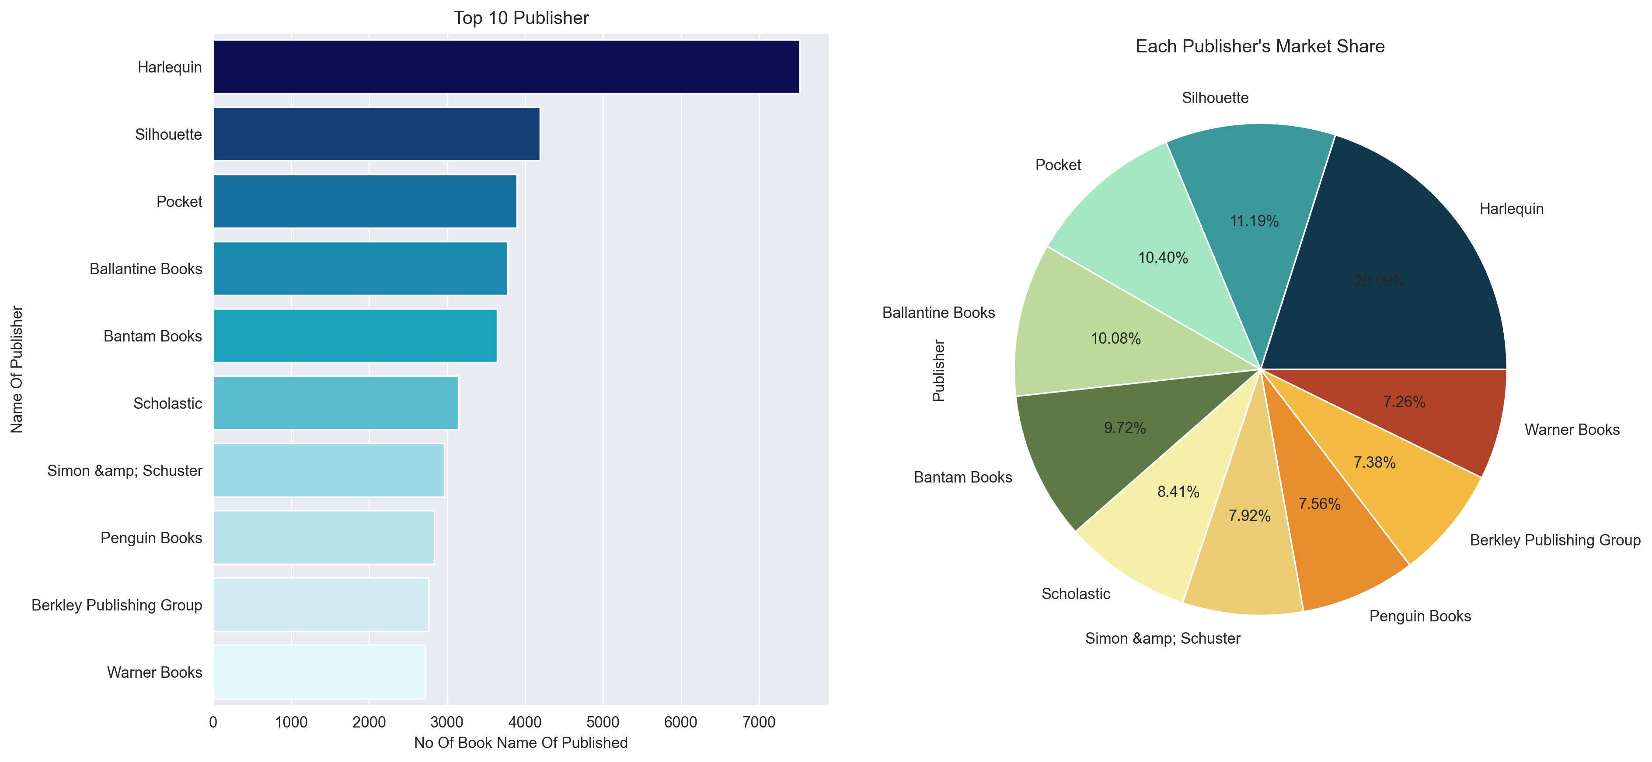
The graph shows the top 10 Publishers together with their market share

Slide 18
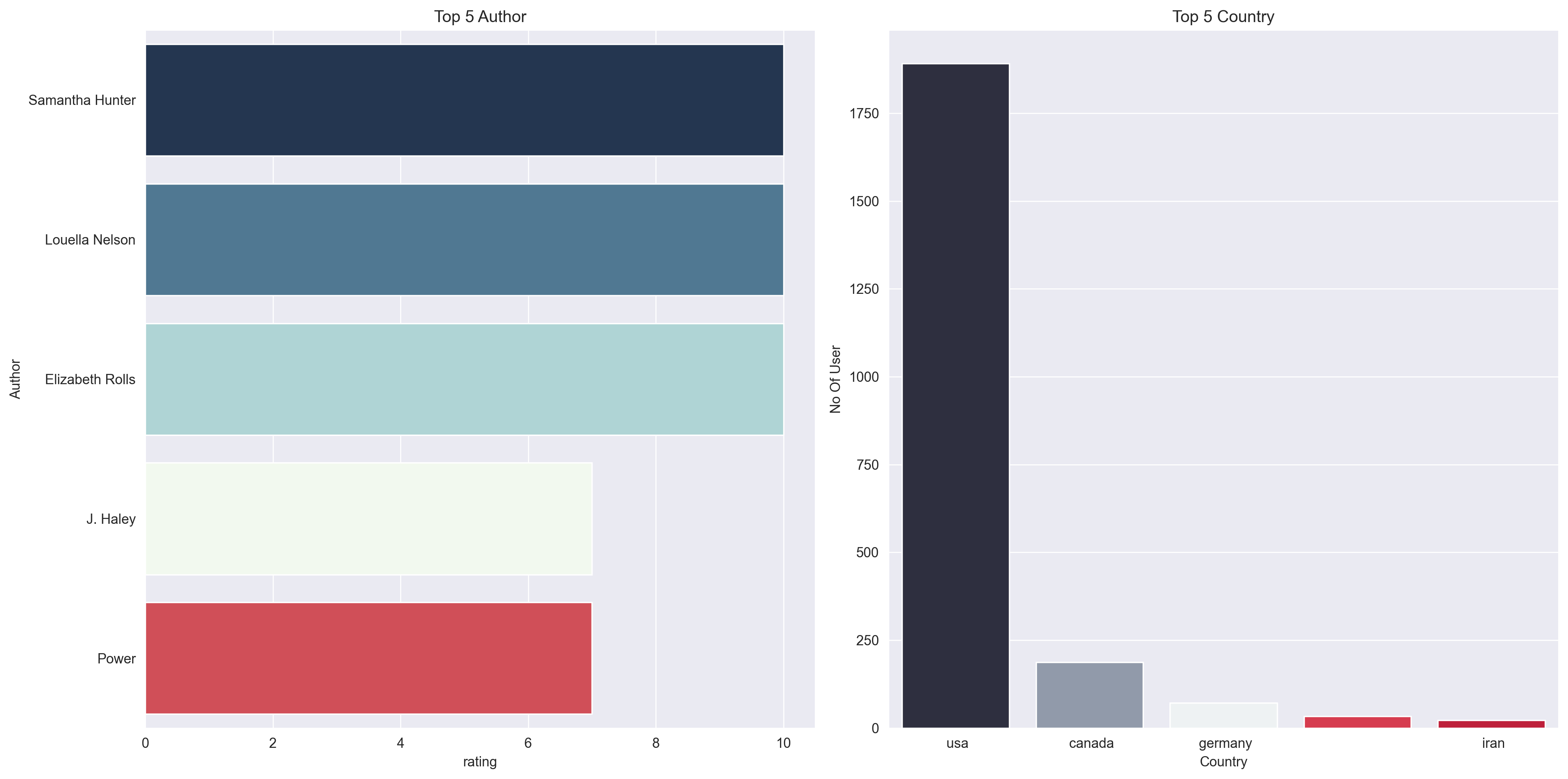
The graph shows the top 5 Harlequin author and top 5 country by active user

Slide 19
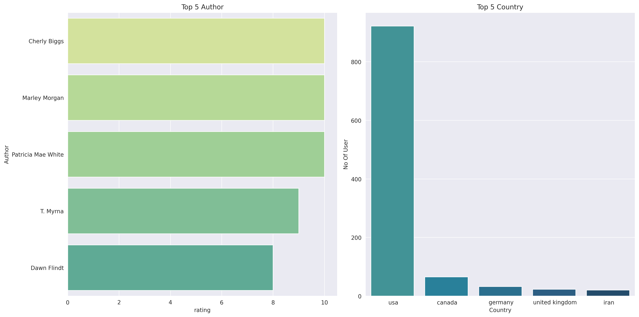
The graph shows the top 5 Silhouette author and top 5 country by active user

Slide 20
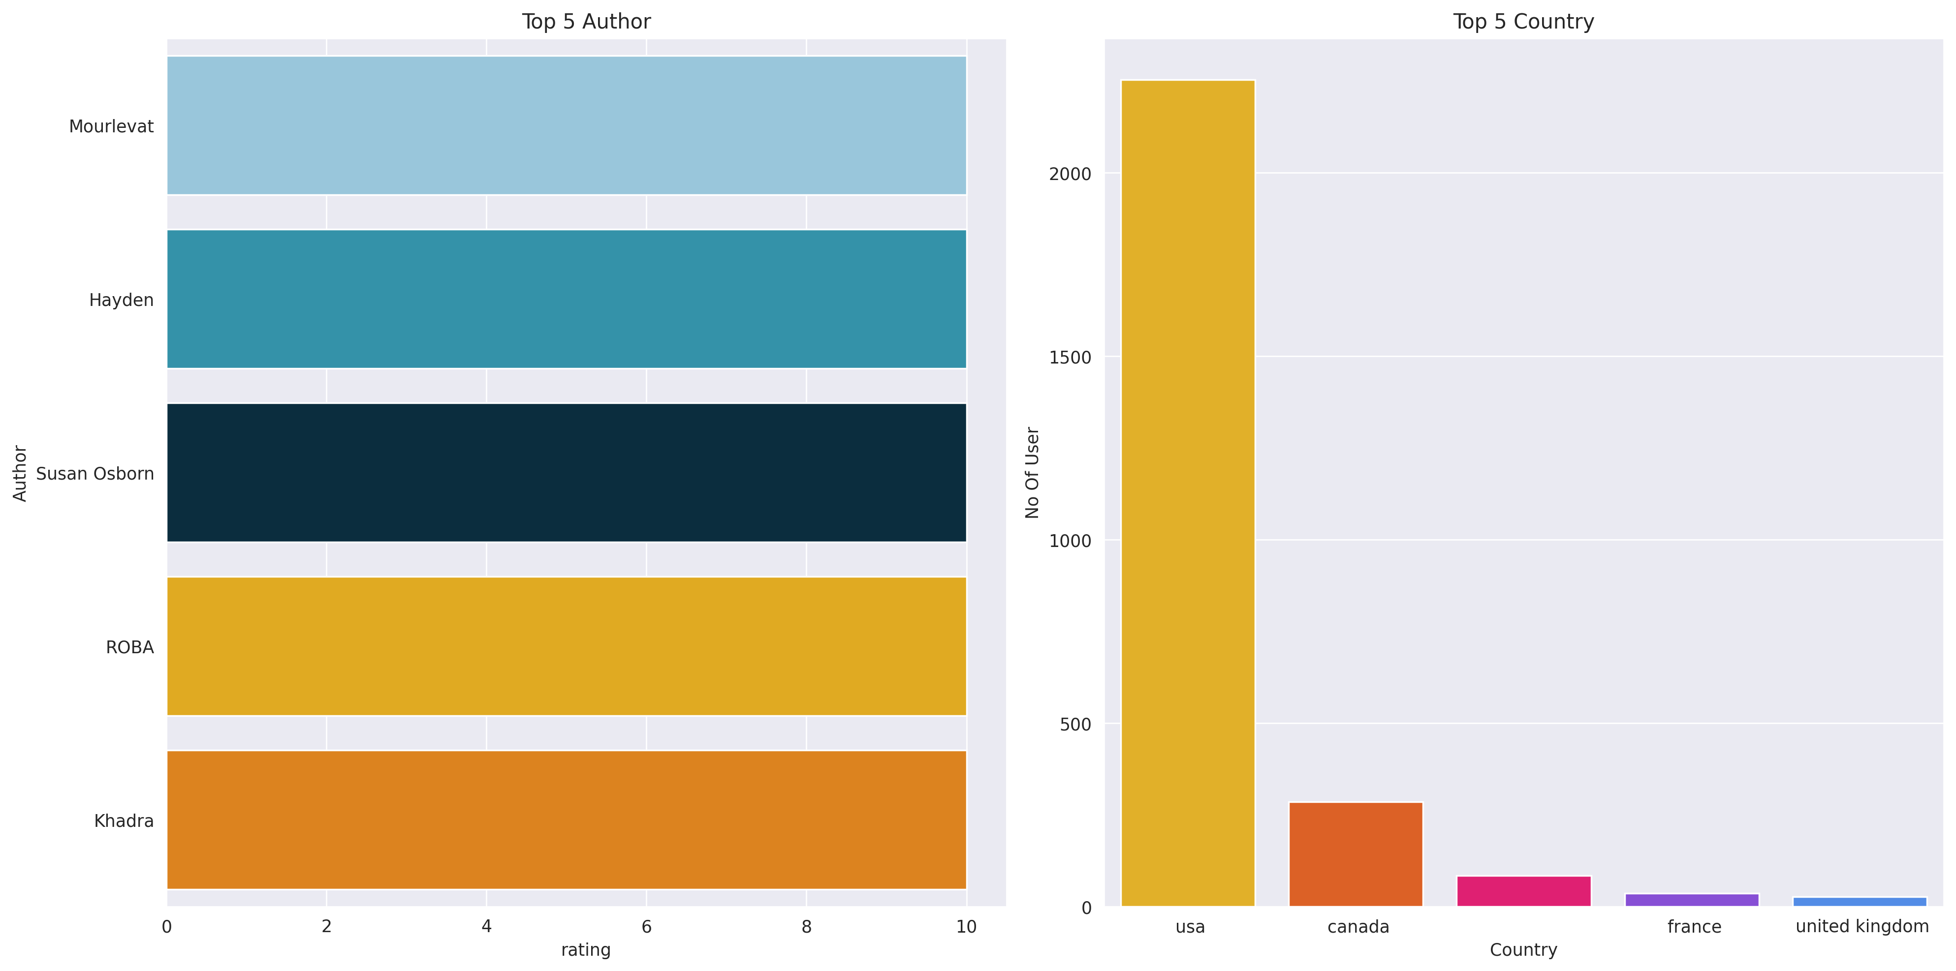
The graph shows the top 5 Pocket author and top 5 country by active user

Slide 21
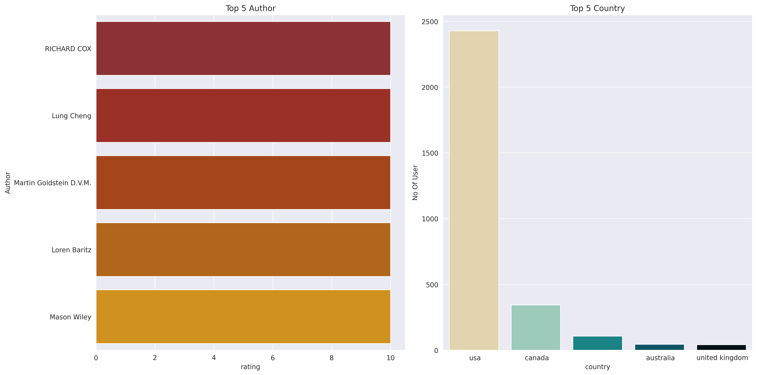
The graph shows the top 5 Ballantine author and top 5 country by active user

Slide 22
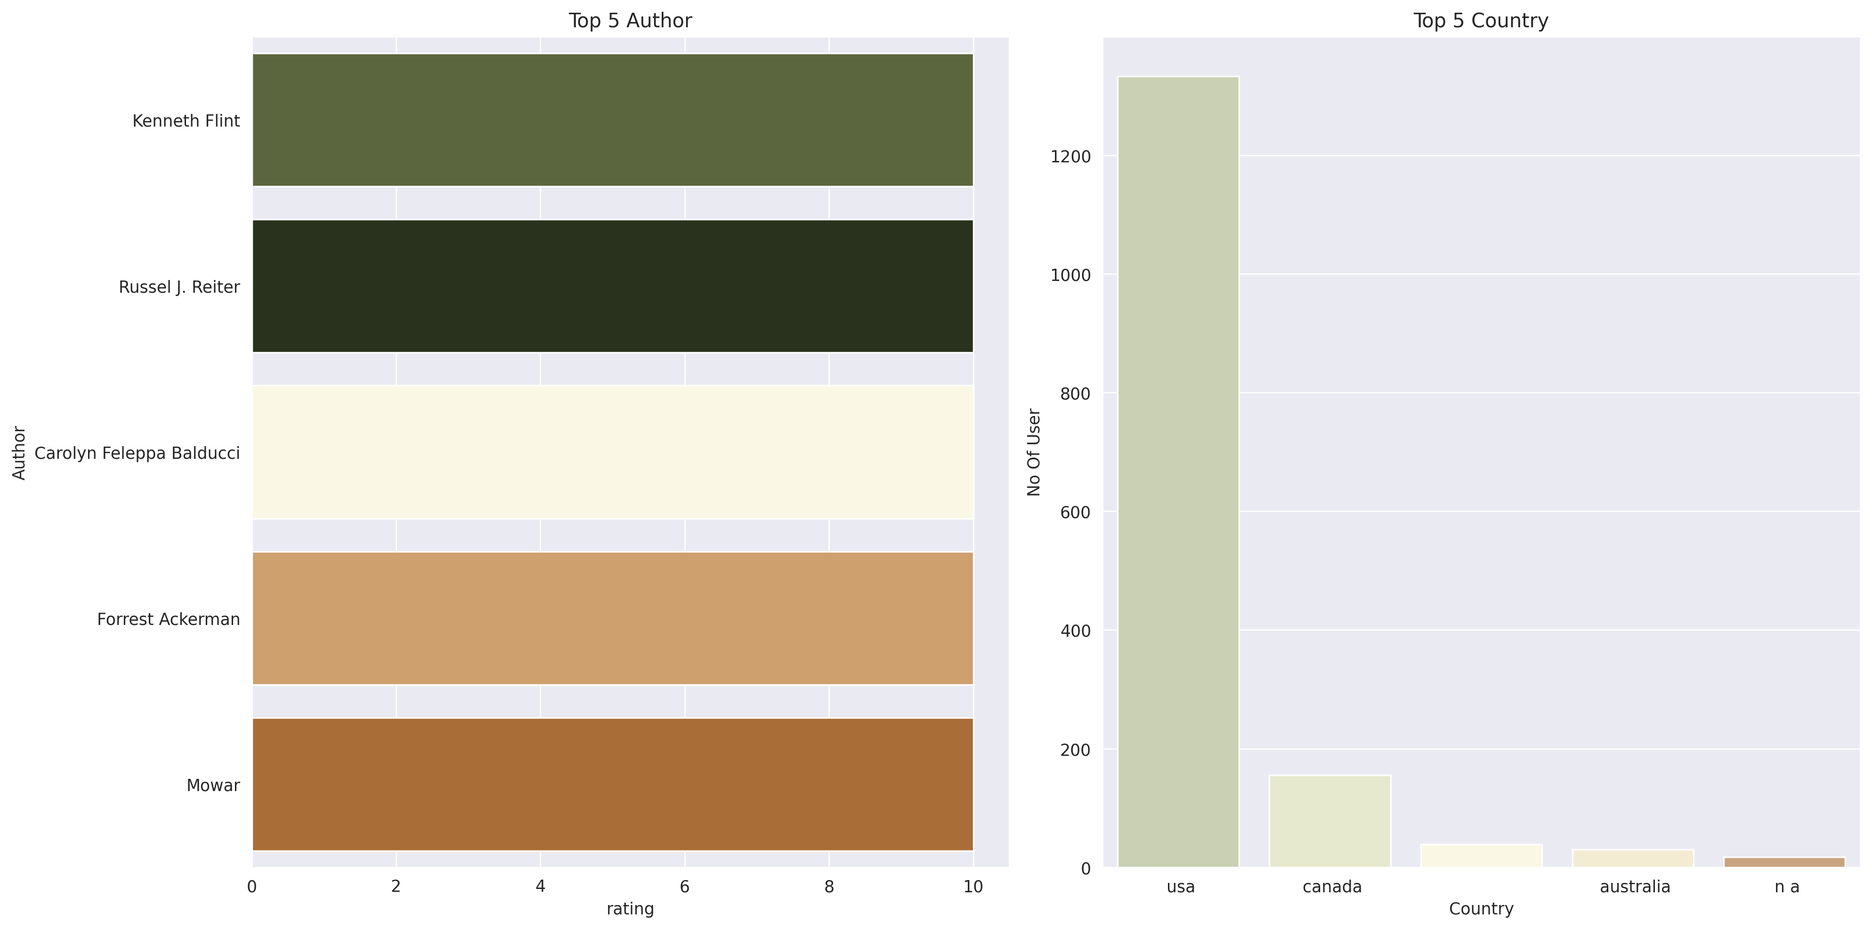
The graph shows the top 5 Bantam author and top 5 country by active user

Slide 23
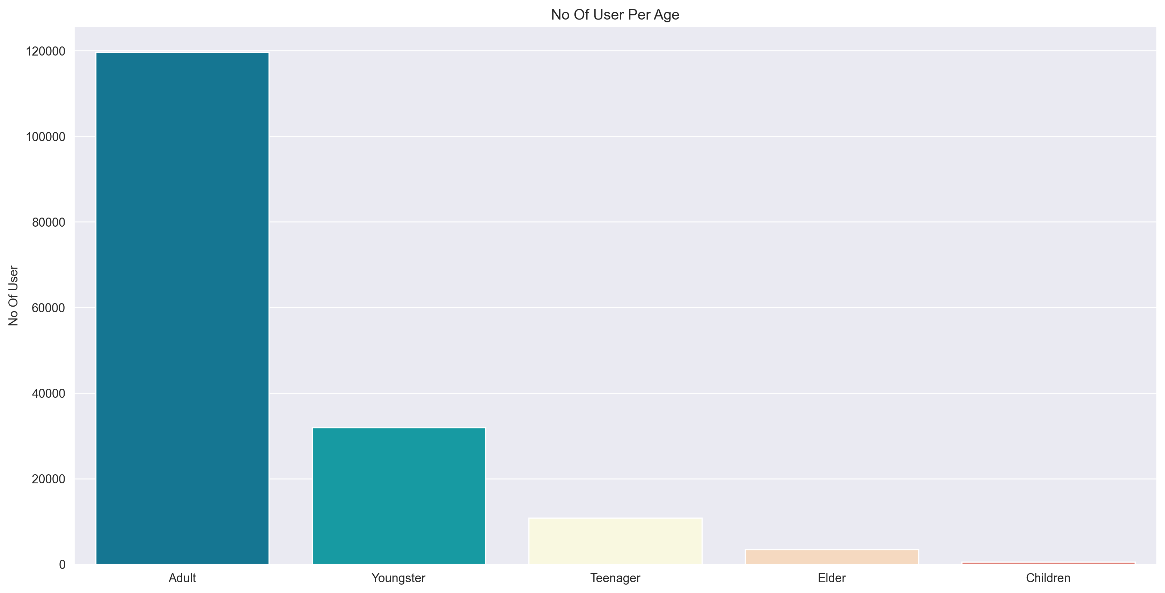
Data Visualization of Age
This graph displays the no. of user per age

Slide 24
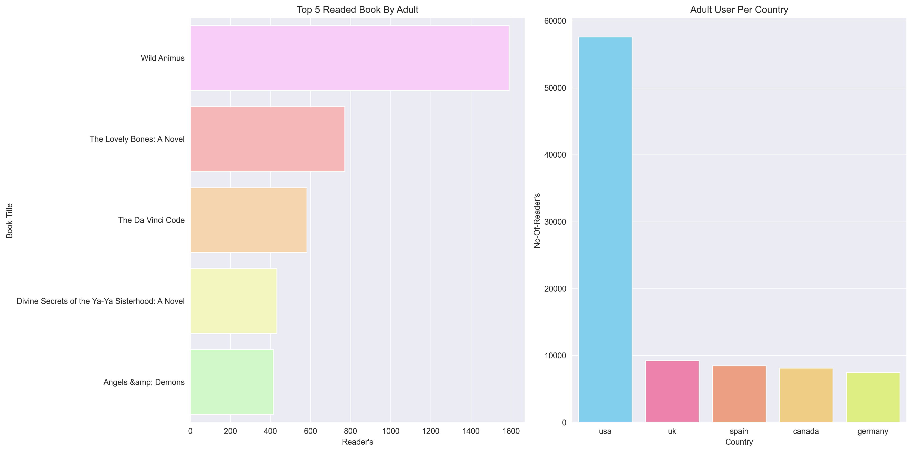
The graph shows the top 5 Readed book by Adult and top 5 country by active user

Slide 25
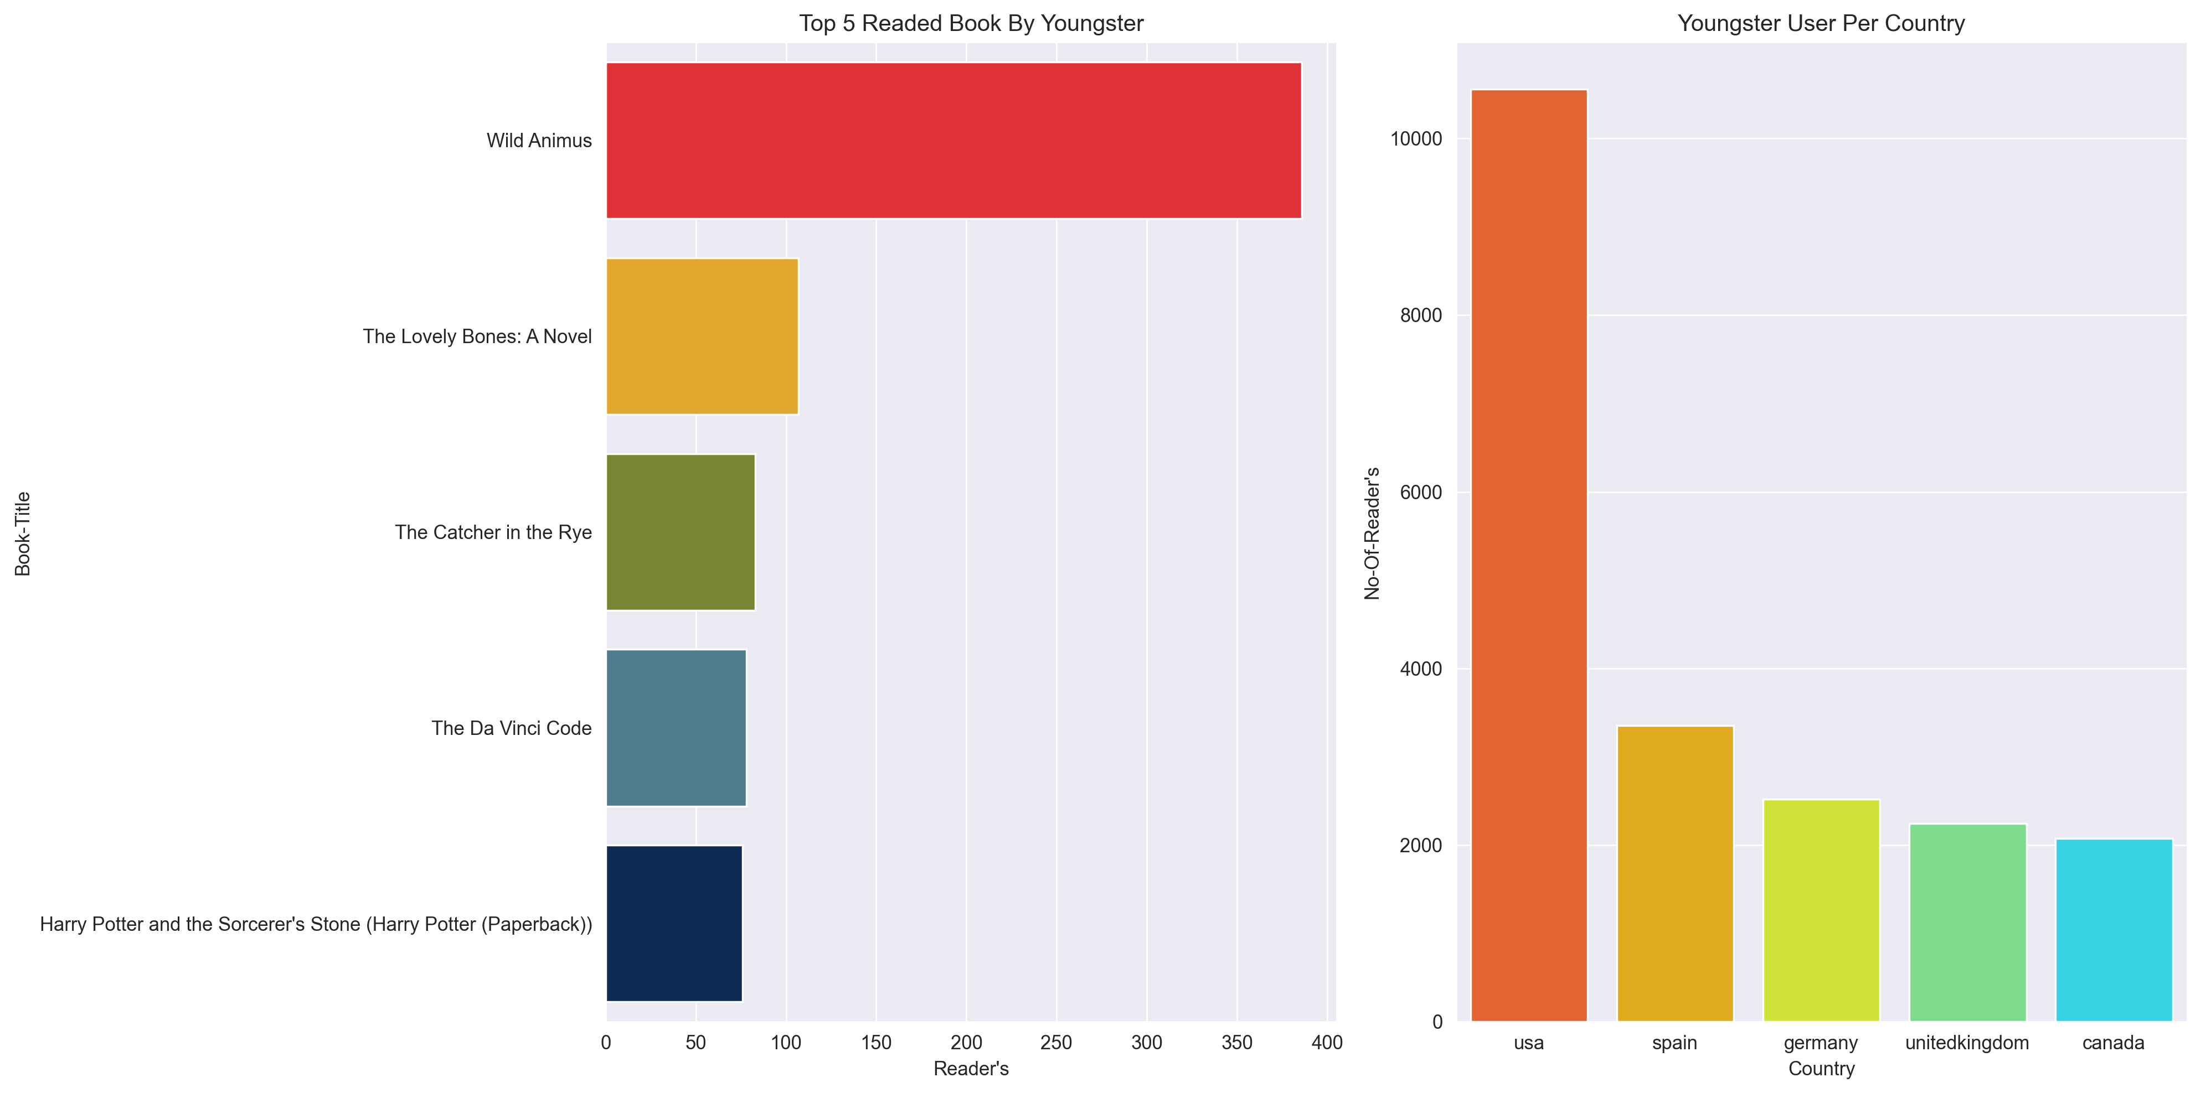
The graph shows the top 5 Readed book by Youngster and top 5 country by active user

Slide 26
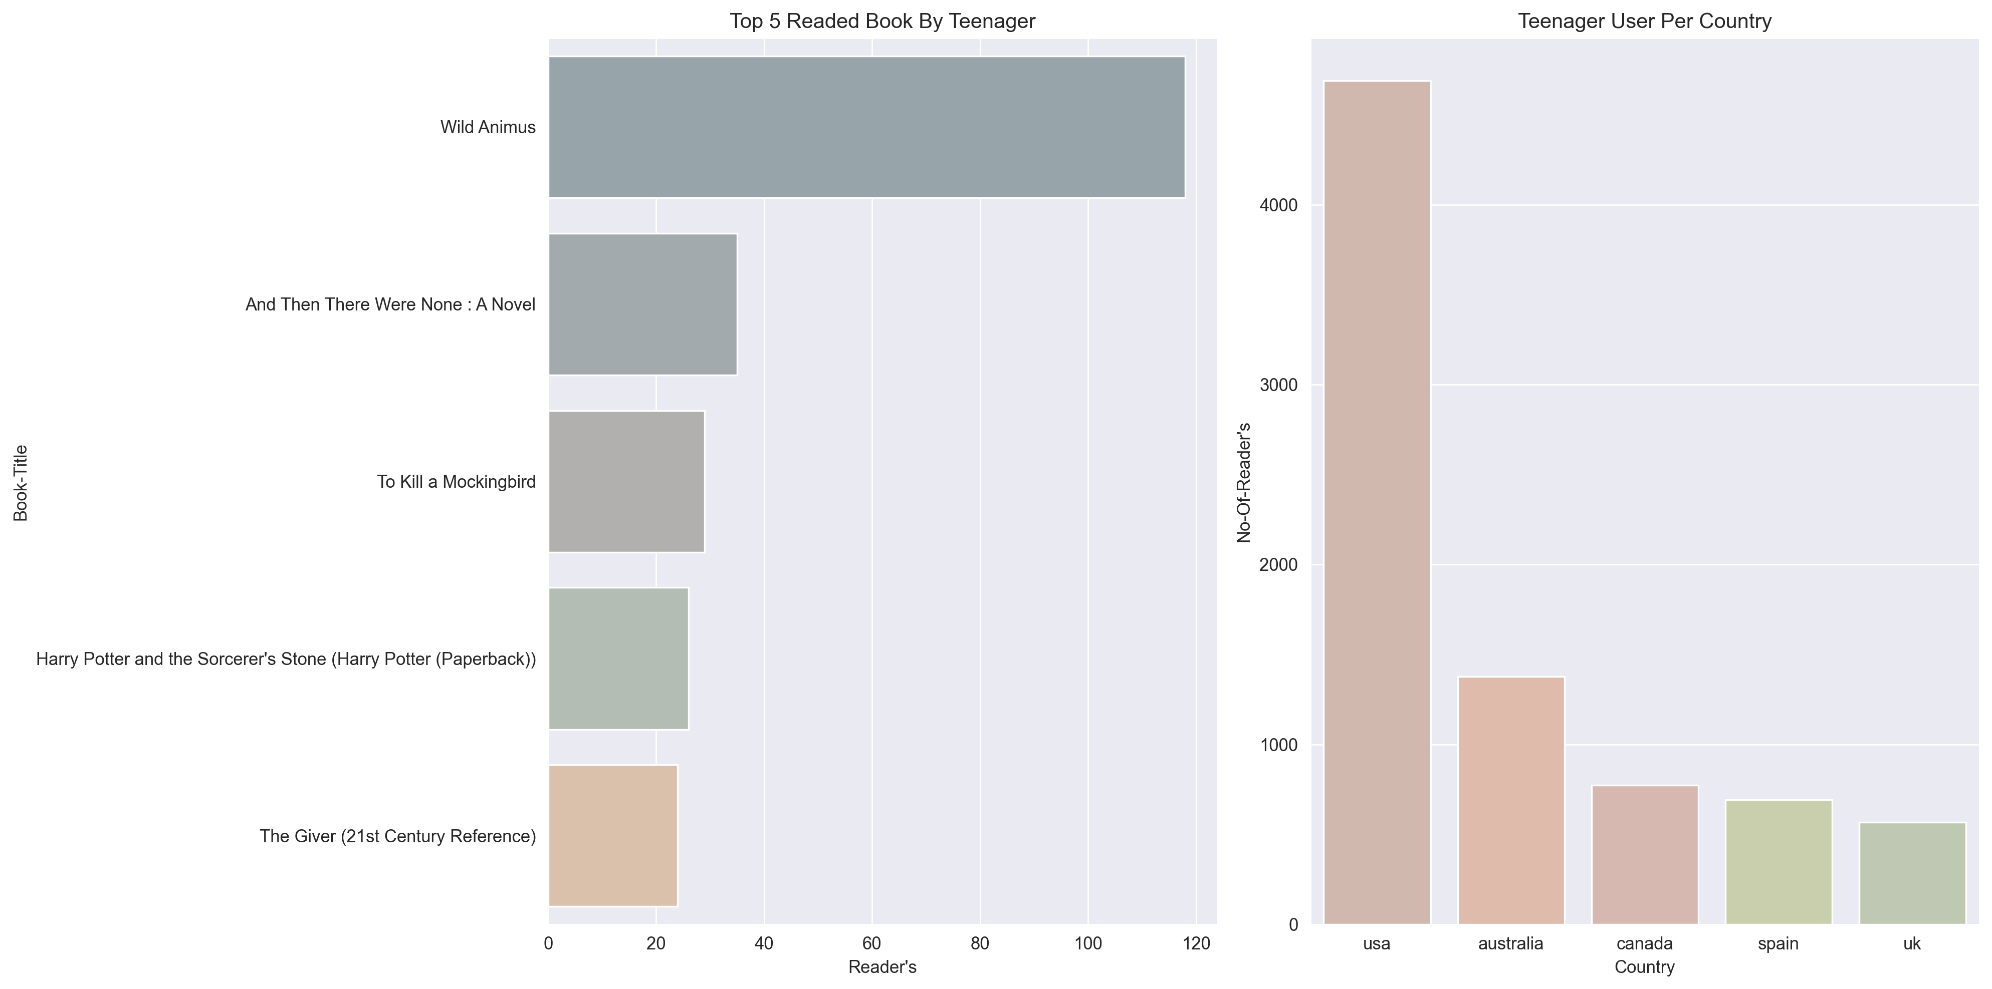
The graph shows the top 5 Readed book by Teenager and top 5 country by active user

Slide 27
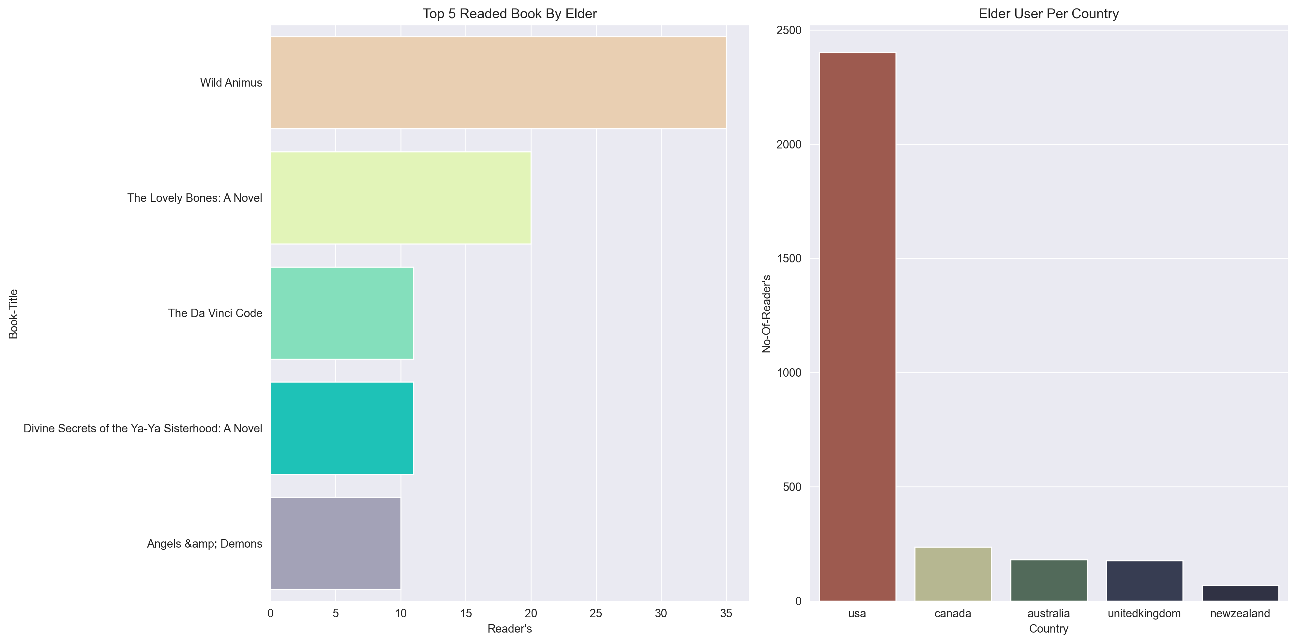
The graph shows the top 5 Readed book by Elder and top 5 country by active user

Slide 28
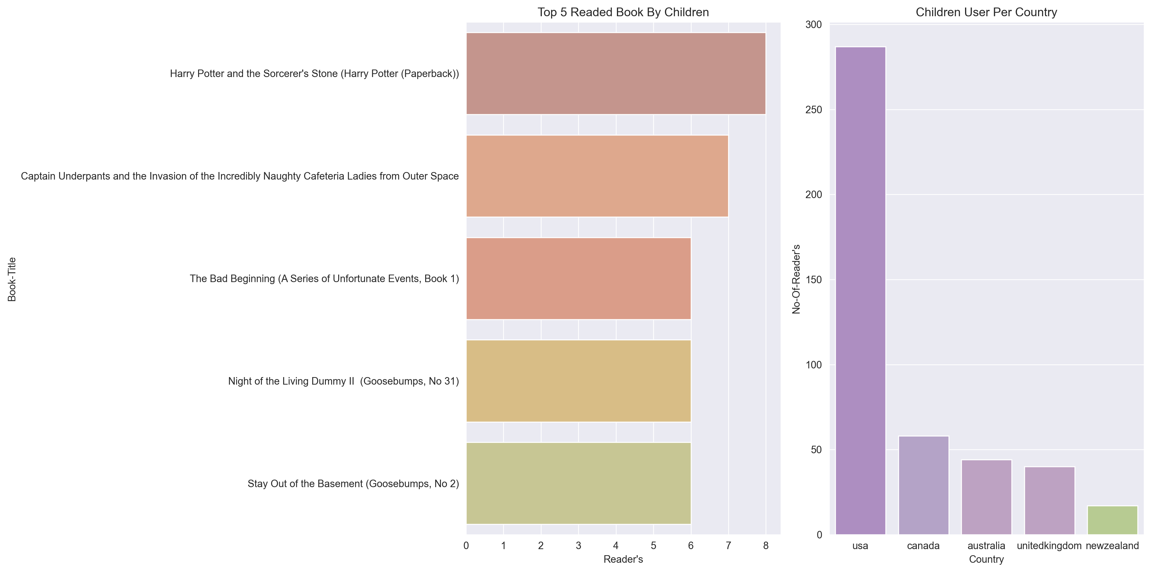
The graph shows the top 5 Readed book by Children and top 5 country by active user

Slide 29
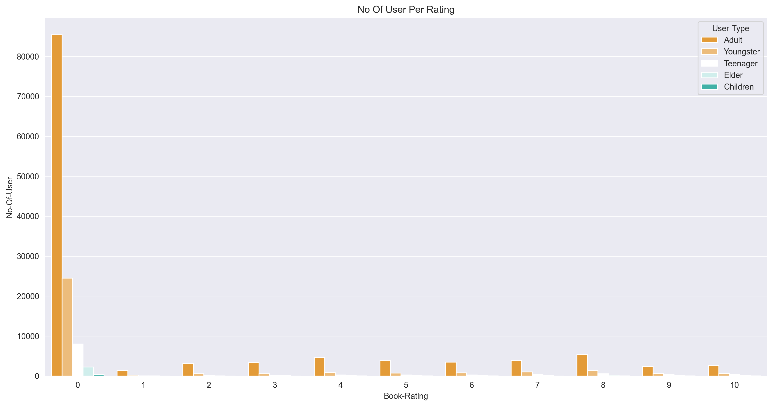
This graph displays the no. of user per Rating ( With Zero Rating )

Slide 30
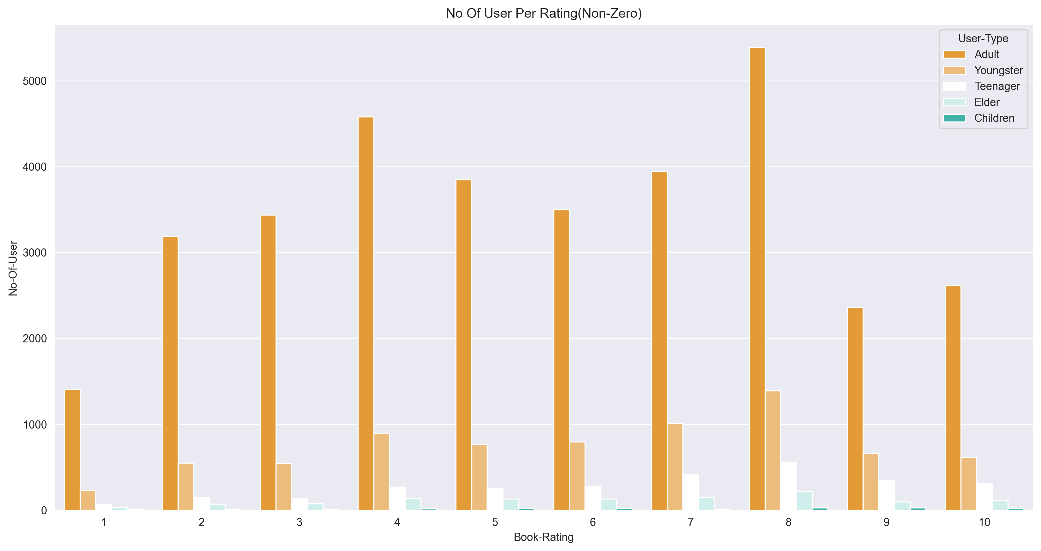
This graph displays the no. of user per Rating ( Without Zero Rating )

Slide 31
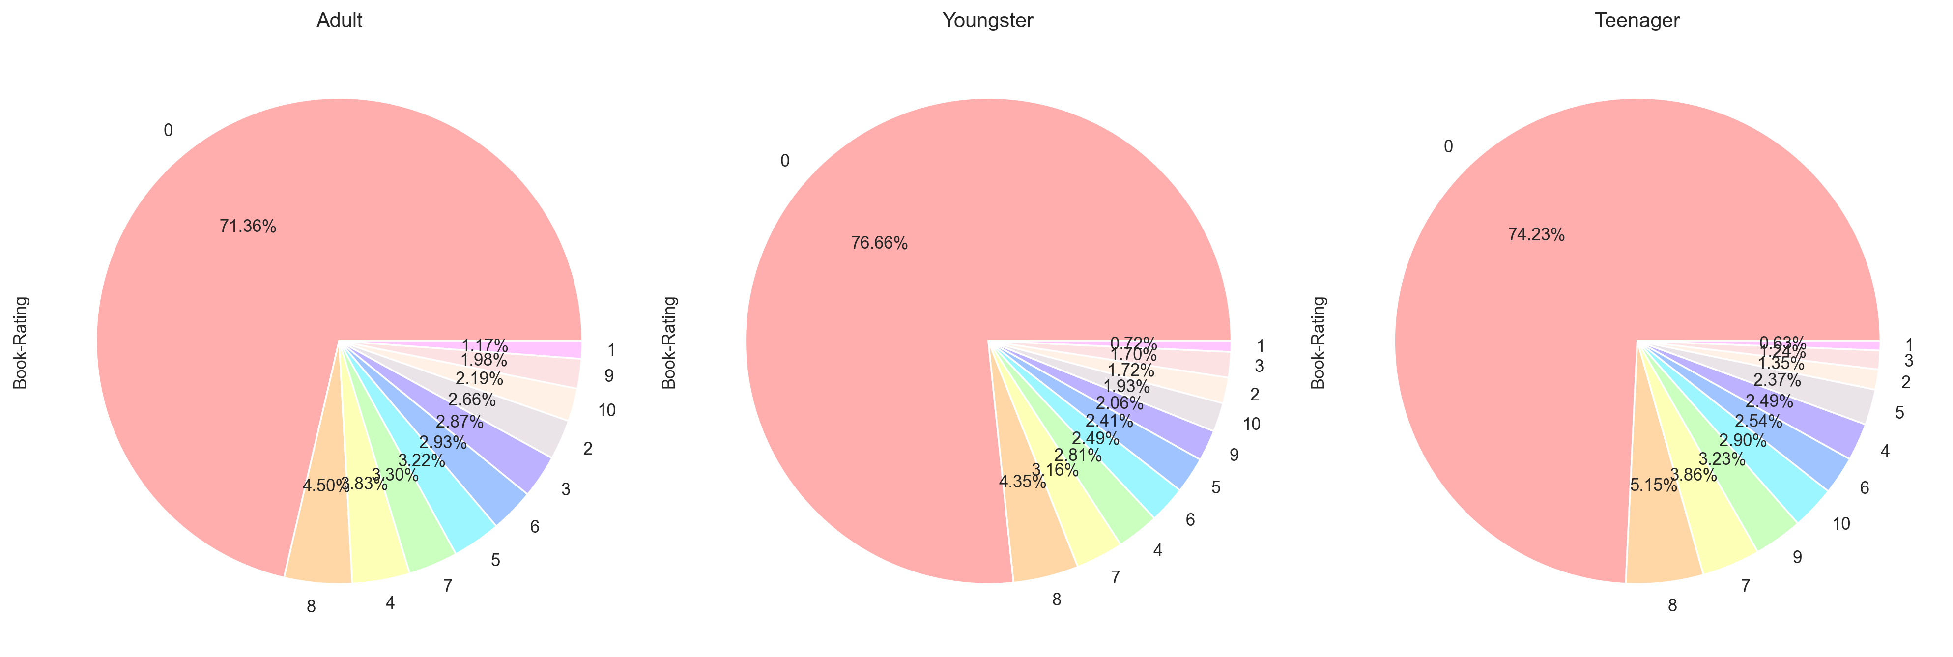
This graph shows percentage of user per rating

Slide 32
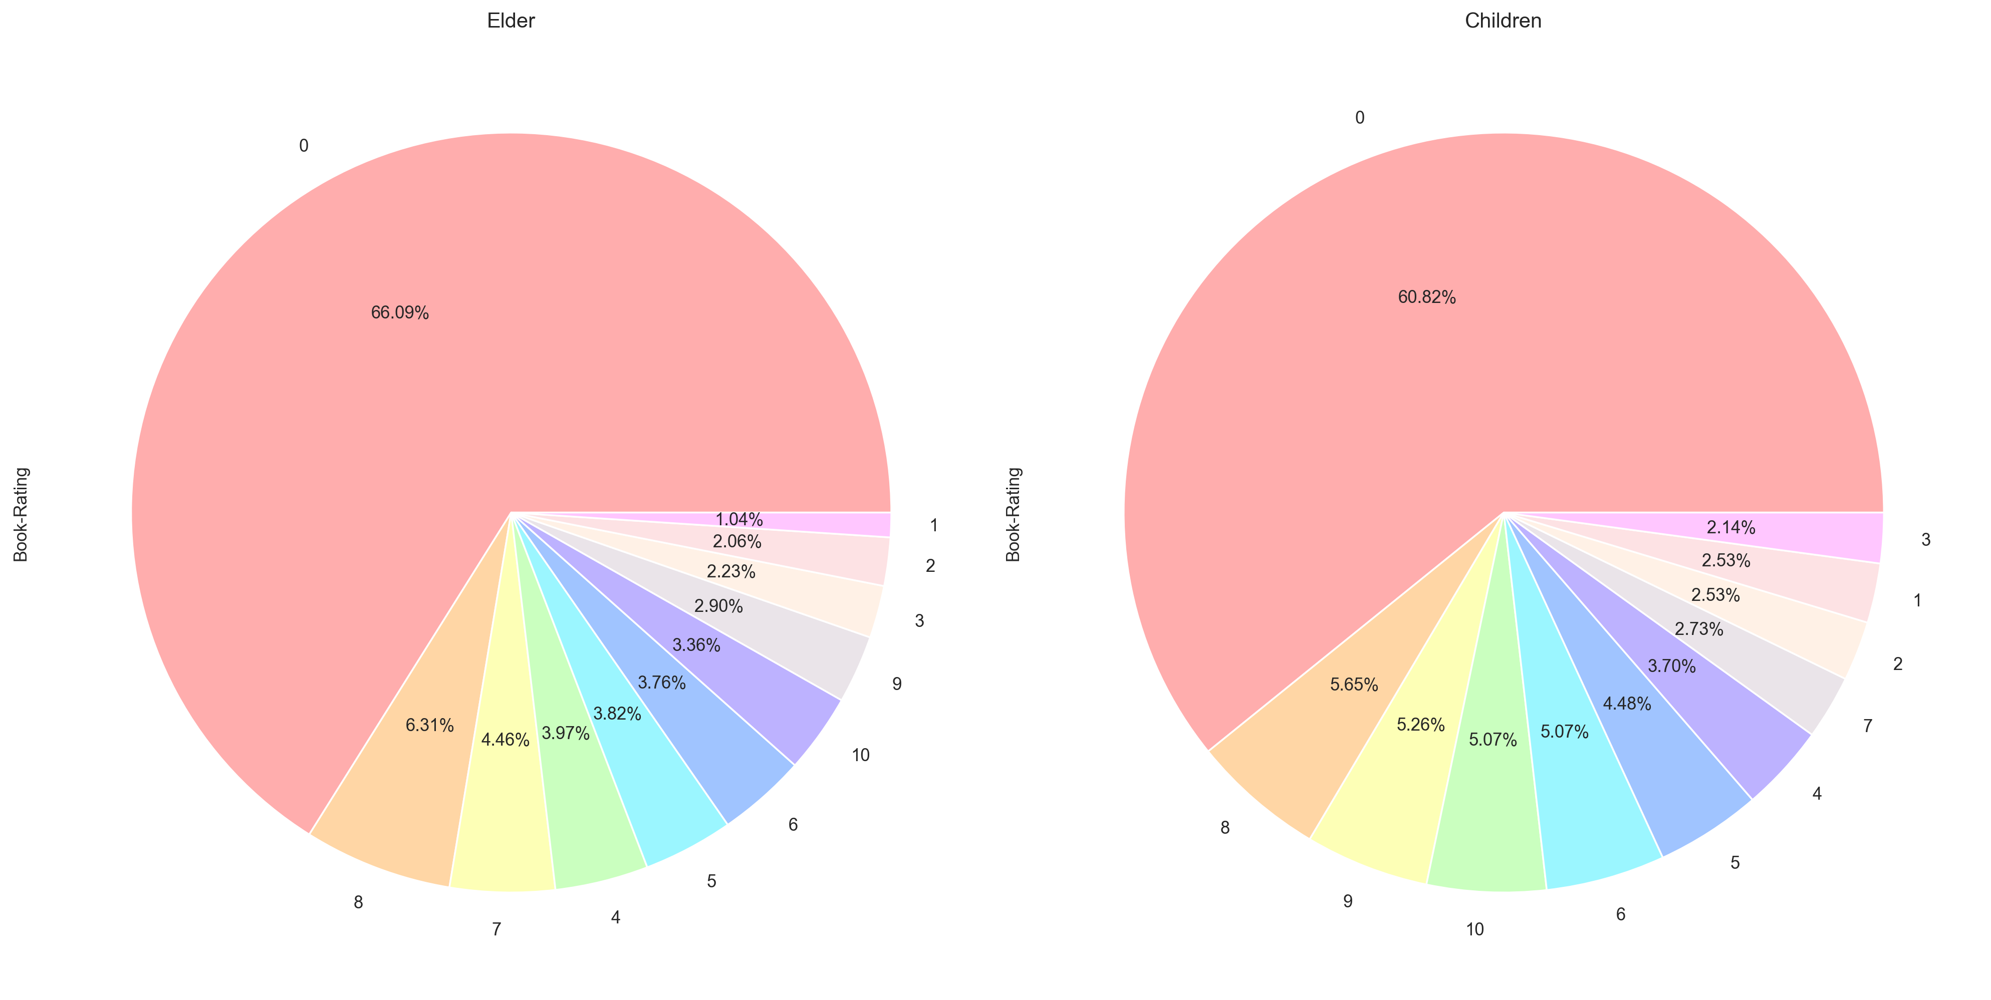
This graph shows percentage of user per rating

Slide 33
Model Building
We have built two models of collaborative filtering to recommend items to users based on their preferences. Collaborative filtering is a technique that uses the ratings or feedback of similar users or items to make predictions. Our models are:
Area based collaborative filtering: This model groups users by their geographic location and recommends items that are popular in their area. We have divided the users into six regions: USA, Canada, United Kingdom, Germany, Australia, and others.
Age based collaborative filtering: This model groups users by their age group and recommends items that are suitable for their age. We have divided the users into six categories: Adult, Youngster, Teenager, Elder, Children, and Other.

Slide 34
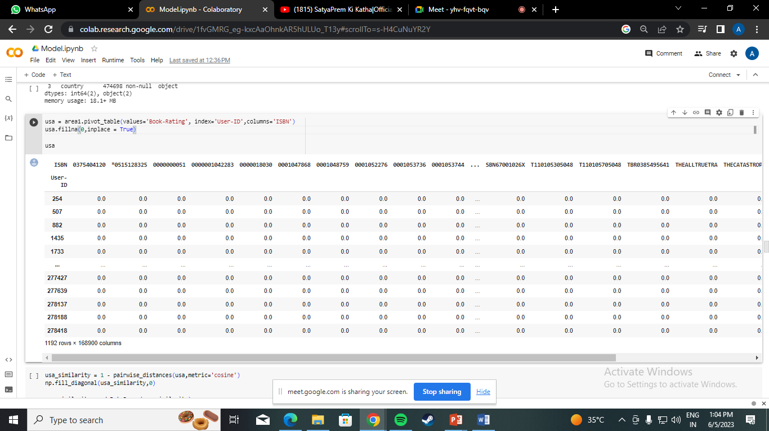
Area based collaborative Filtering
USA
Pivot table

Slide 35
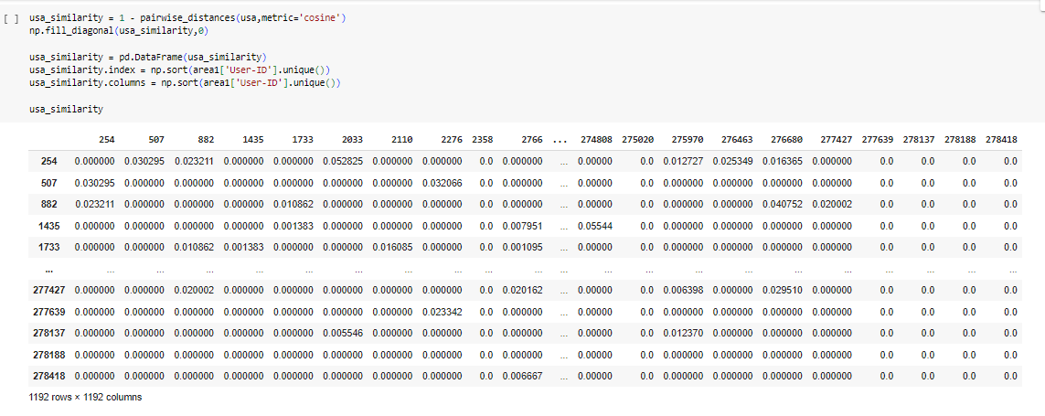
User to User

Slide 36
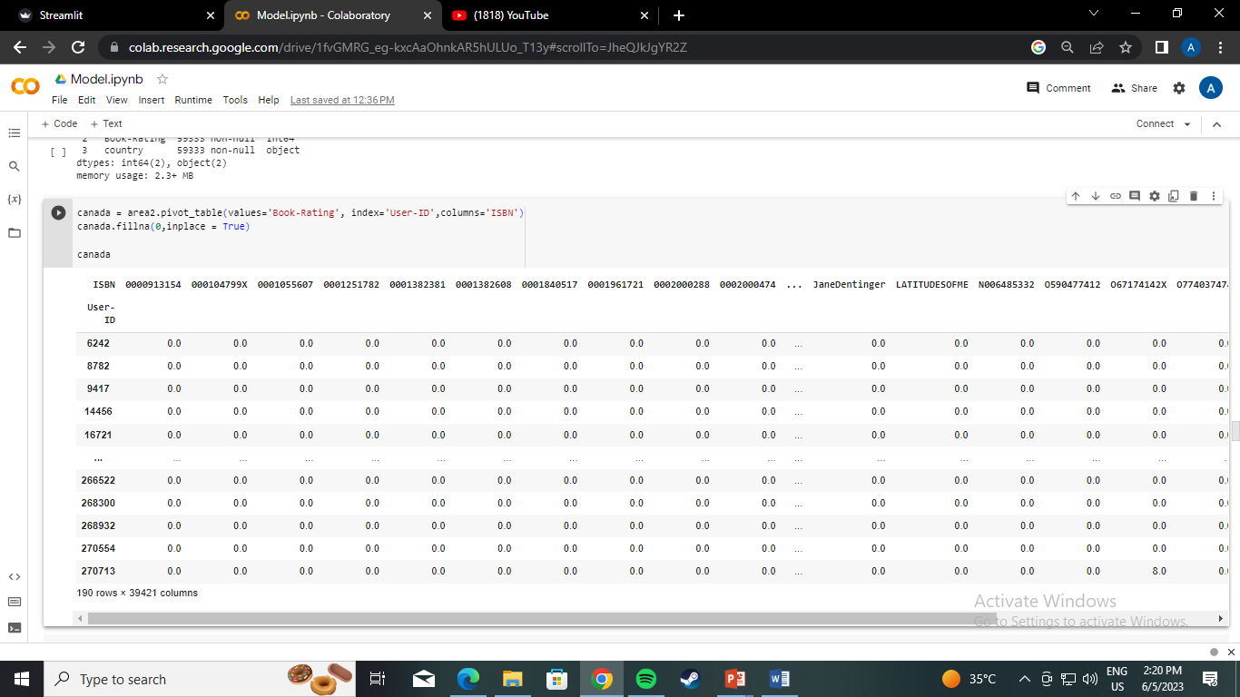
Canada
Pivot table

Slide 37
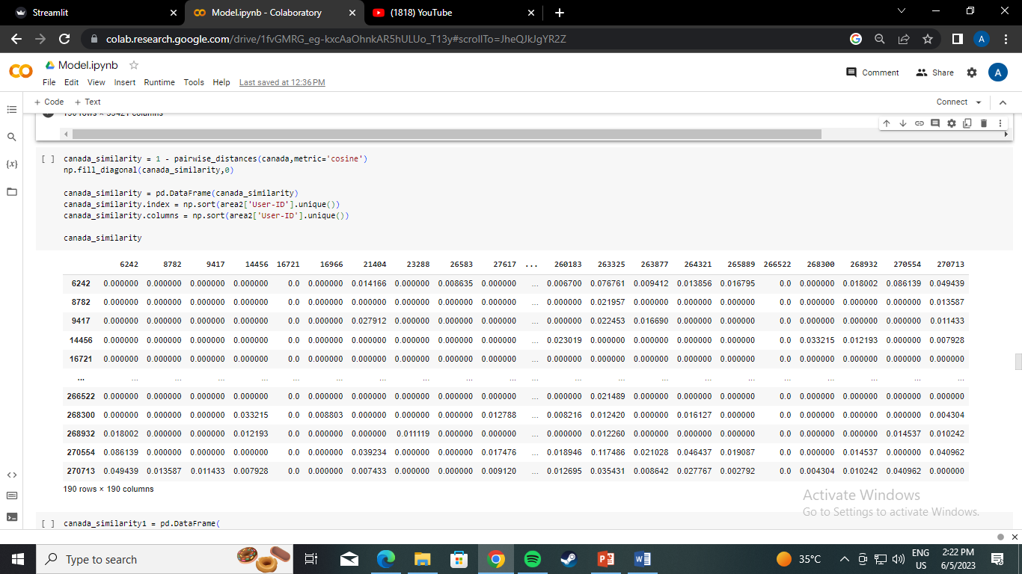
User to User

Slide 38
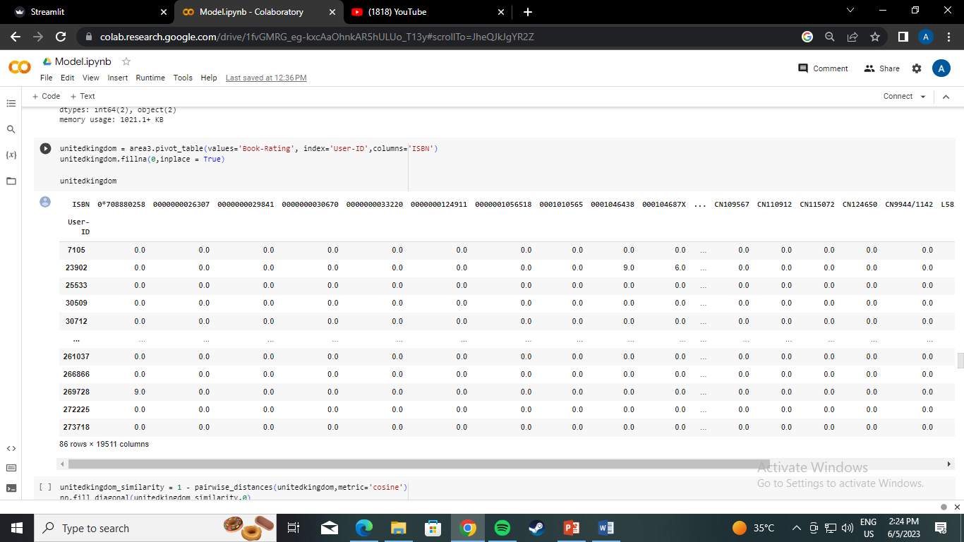
United Kingdom
Pivot table

Slide 39
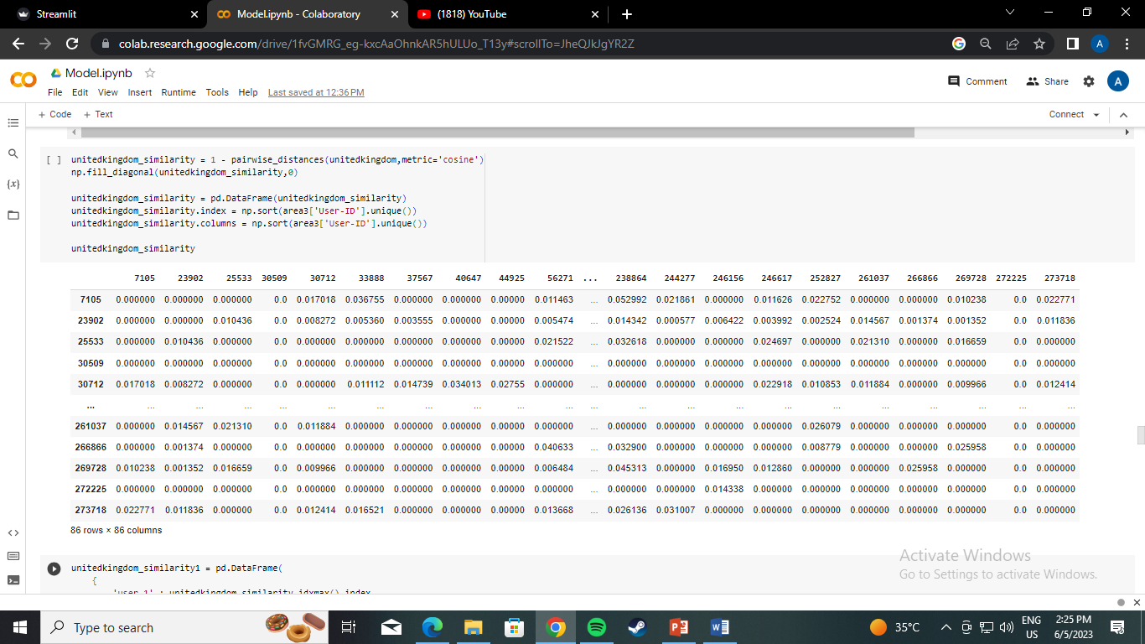
User to User

Slide 40
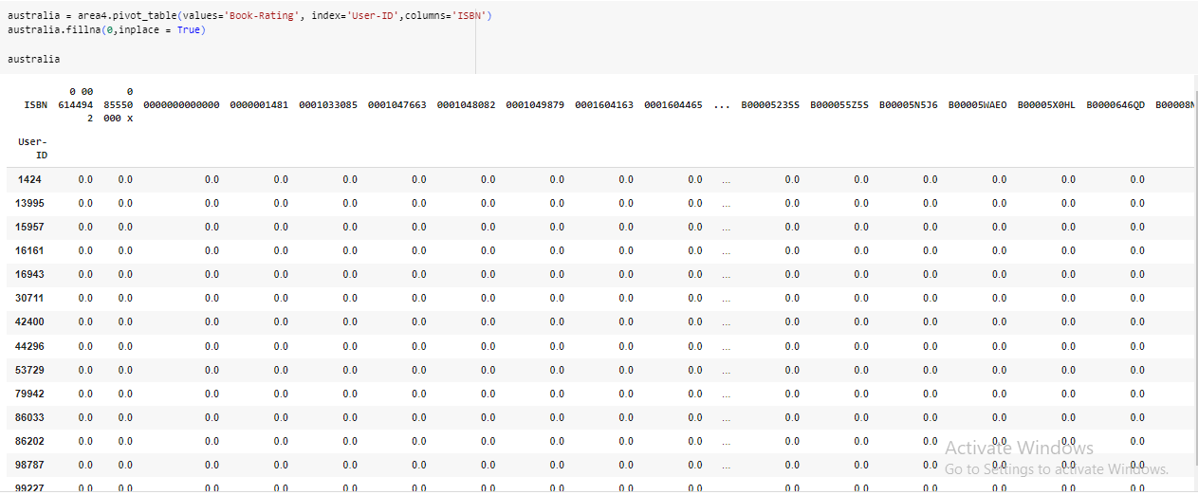
Australia
Pivot table

Slide 41
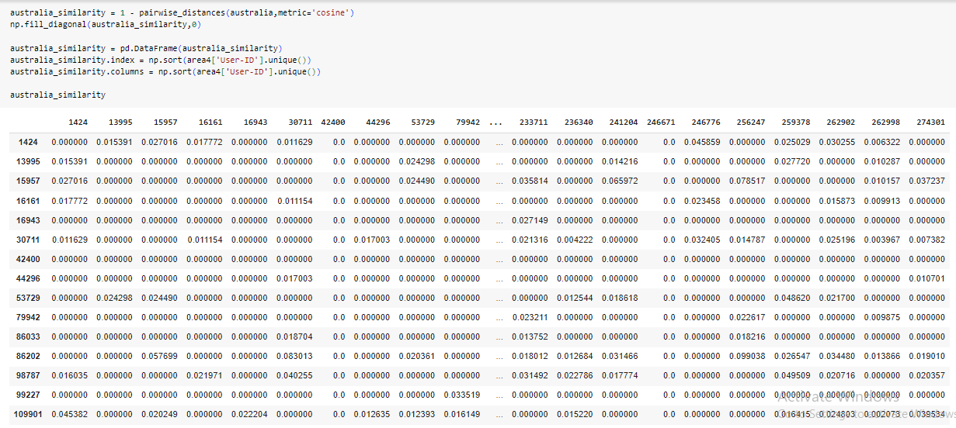
User to User

Slide 42
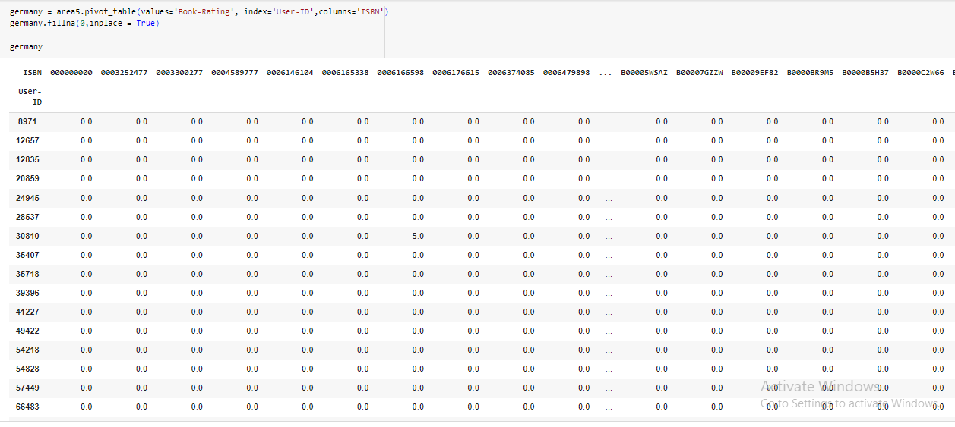
Germany
Pivot table

Slide 43
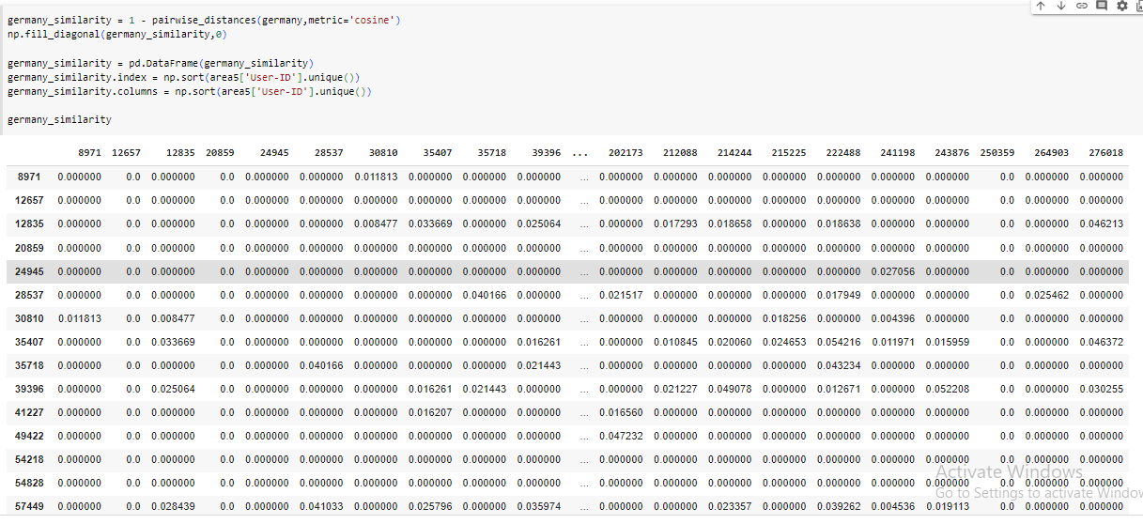
User to User

Slide 44
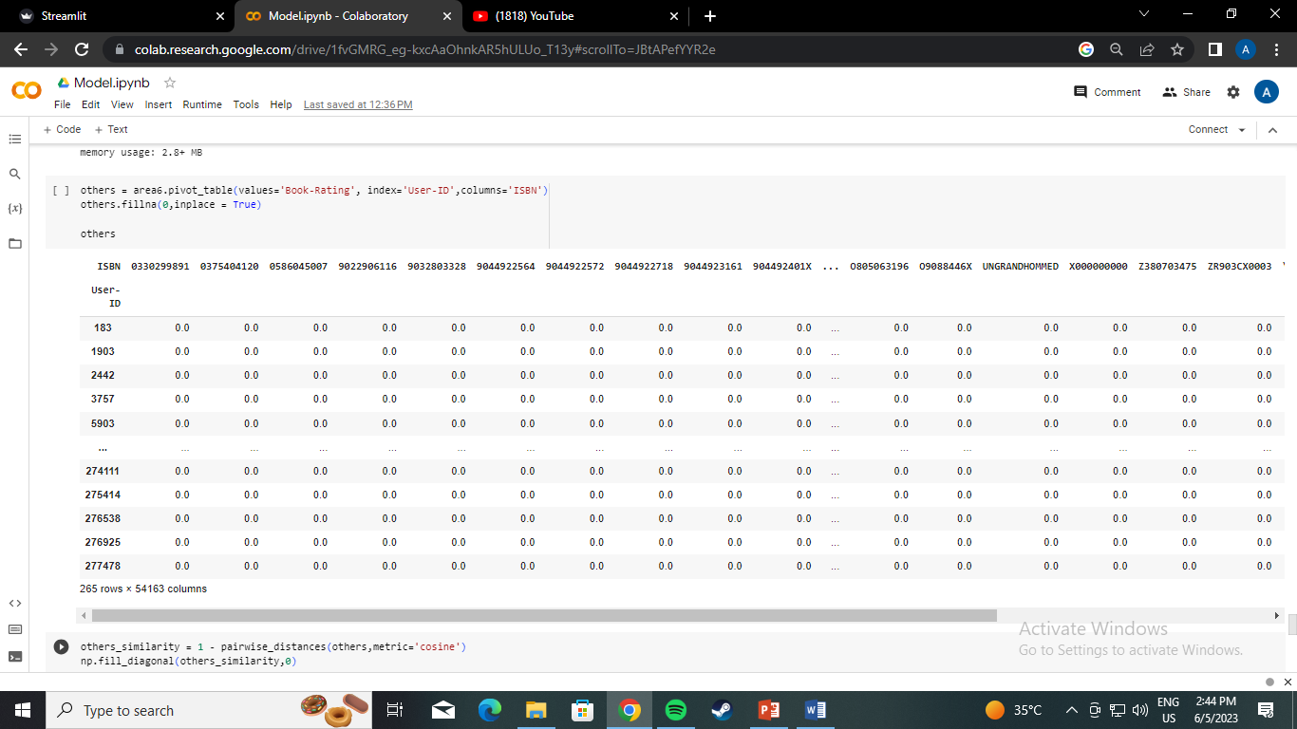
Others
Pivot table

Slide 45
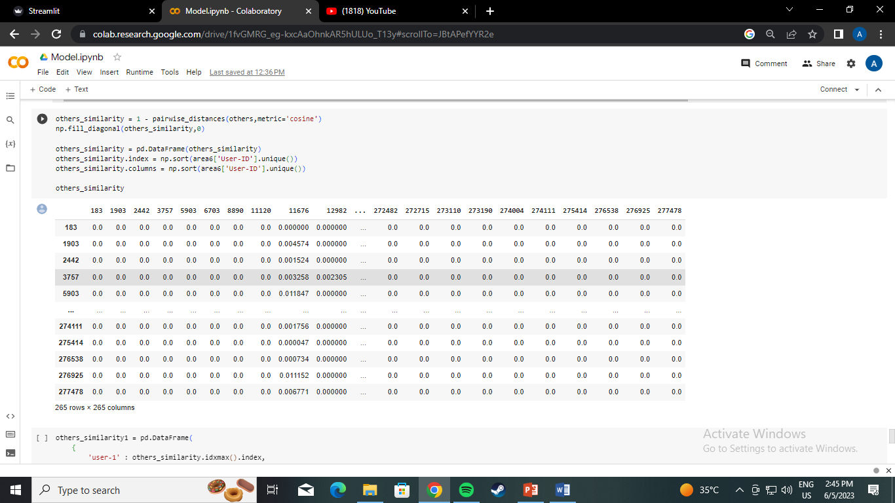
User to User

Slide 46
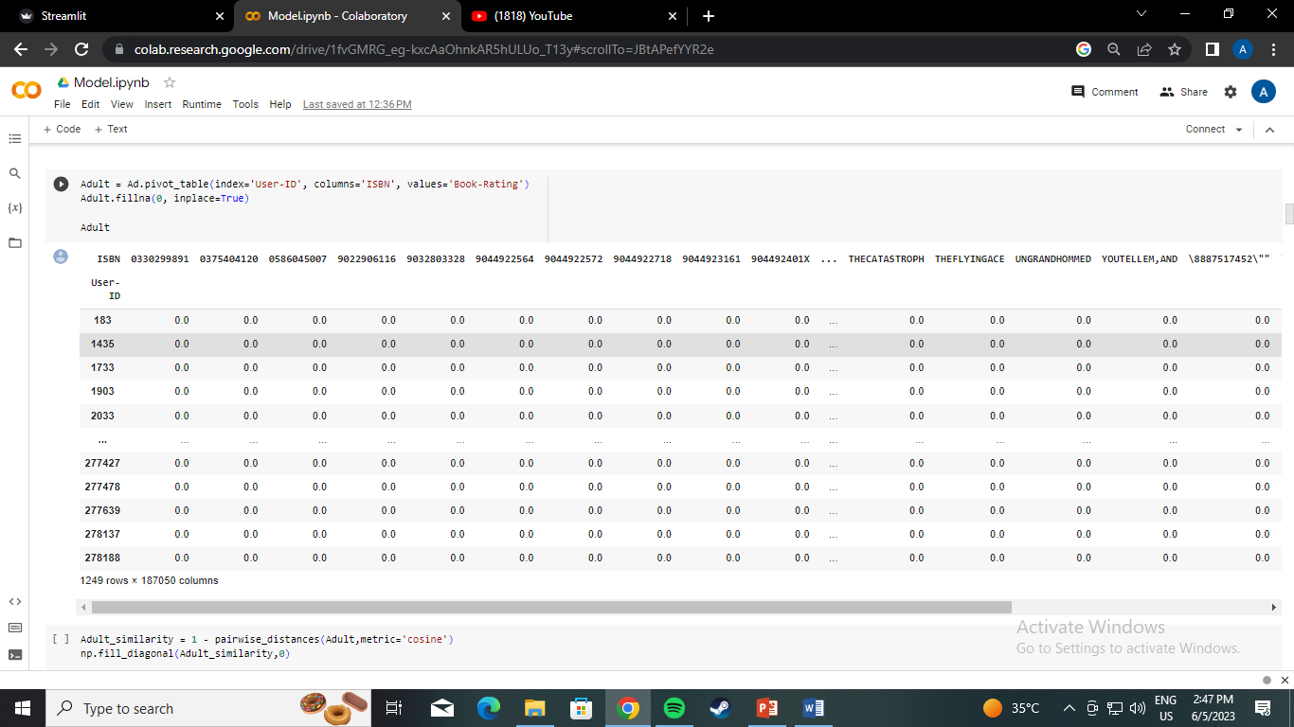
Age based collaborative Filtering
Adult
Pivot table

Slide 47
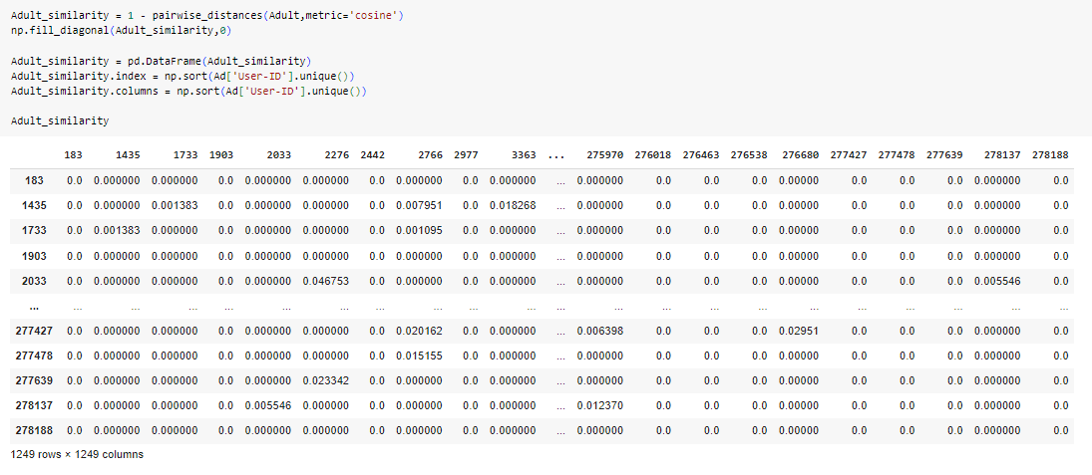
User to User

Slide 48
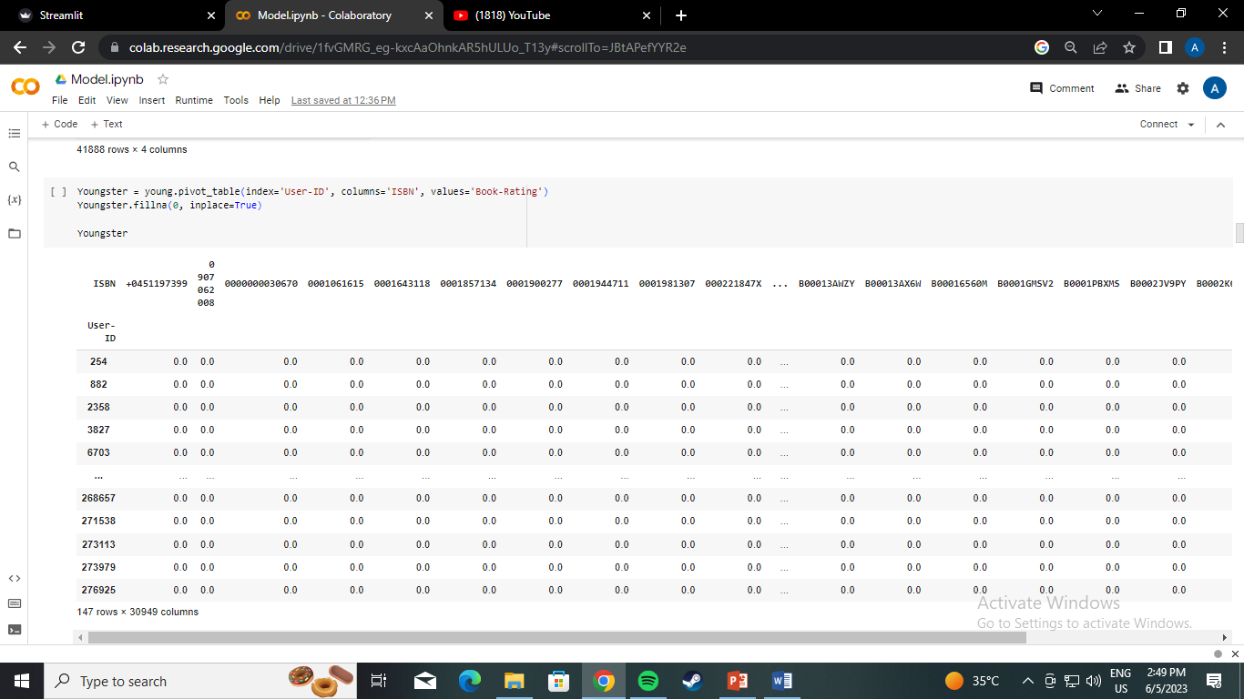
Youngster
Pivot table

Slide 49
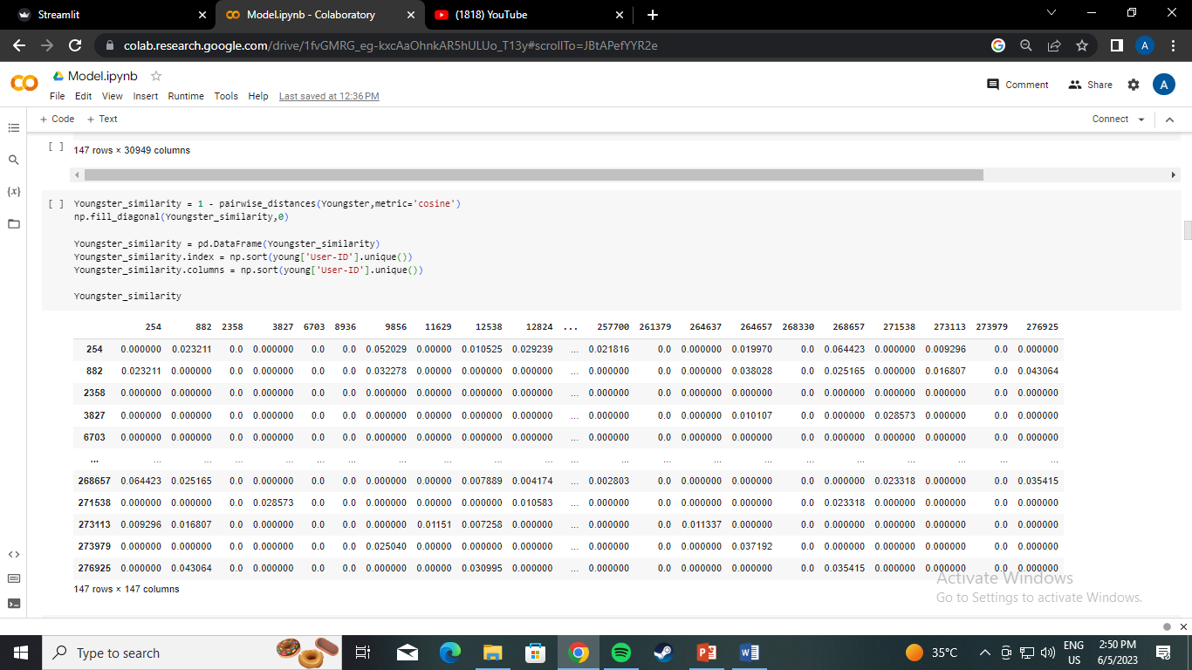
User to User

Slide 50

Teenager
Pivot table

Slide 51

User to User

Slide 52

Elder
Pivot table

Slide 53

User to User

Slide 54

Children
Pivot table

Slide 55

User to User

Slide 56

Other
Pivot table

Slide 57

User to User

Slide 58

Model Validation of Area

Slide 59

Model Validation of Age

Slide 60
Thank You

